Slide 1

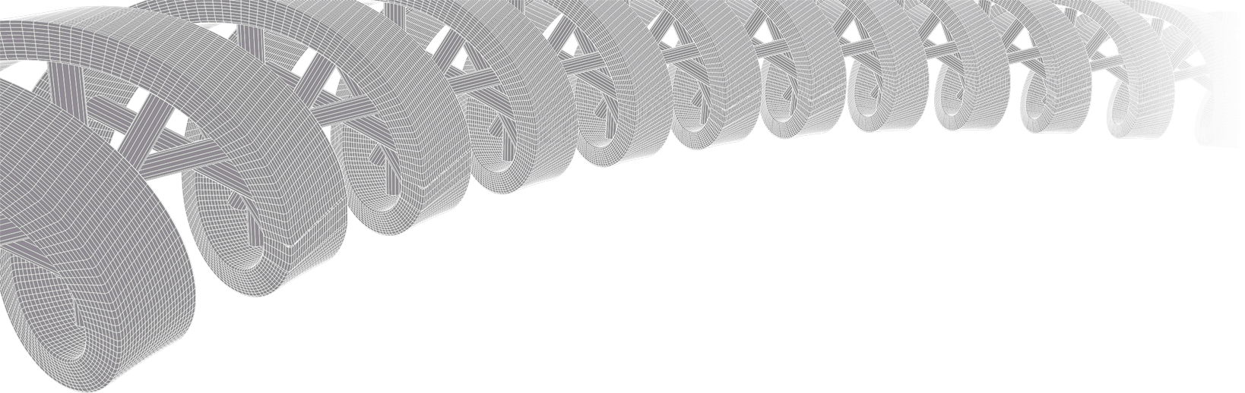
GenViz Module 1: Introduction to genomic data visualization and interpretation
Malachi Griffith, Obi Griffith, Zachary Skidmore
Genomic Data Visualization and Interpretation
April 8-12, 2019
Freie Universität Berlin

Slide 2
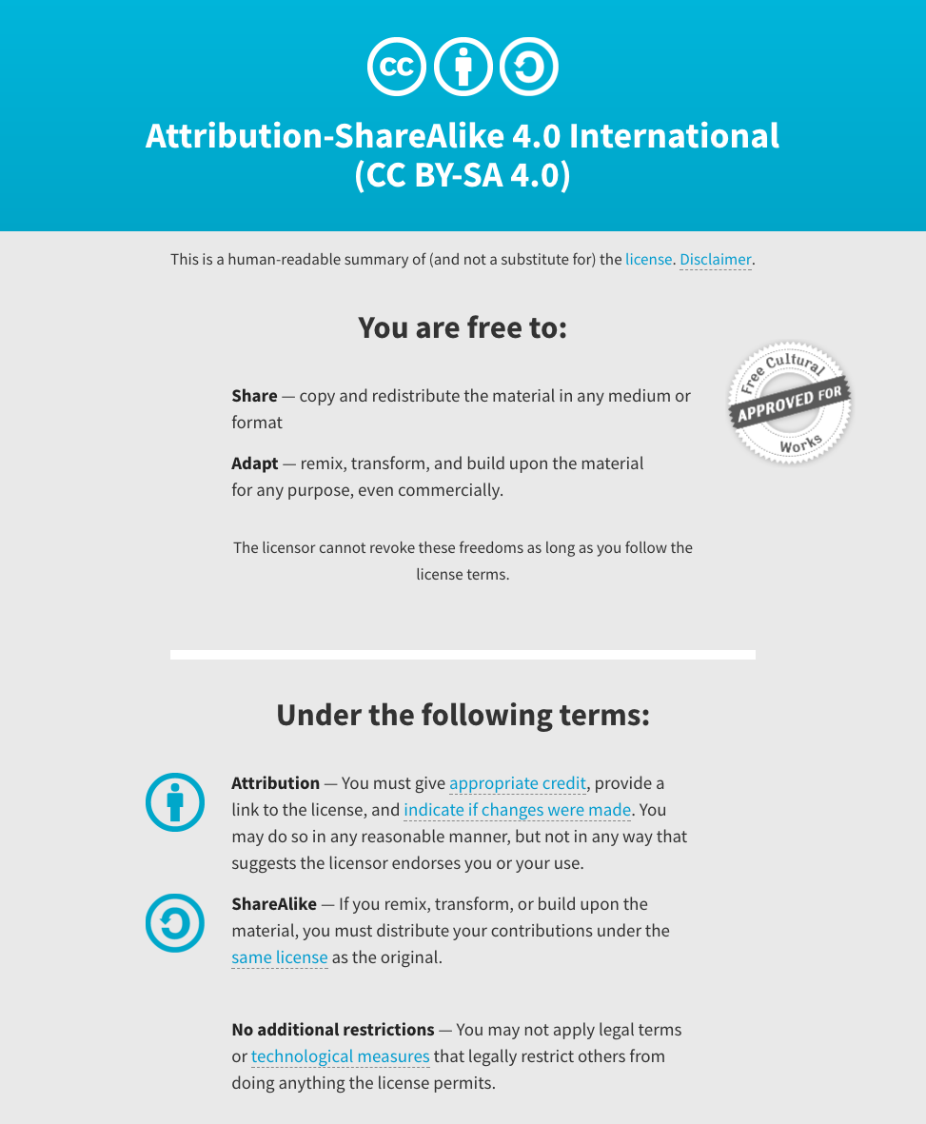
Notes:
Note there are two licenses if effect for this course.
All *content* (lectures, written materials, etc.) are made available under the Creative Commons Attribution-ShareAlike 4.0 International (CC BY-SA 4.0). (https://creativecommons.org/licenses/by-sa/4.0/).
All *code* (R scripts the website code itself) are made available under the MIT License (https://opensource.org/licenses/MIT).

Slide 3
Learning objectives of the course
Module 1: Introduction to genomic data visualization and interpretation
Module 2: Using R for genomic data visualization and interpretation
Module 3: Introduction to GenVisR
Module 4: Expression profiling, visualization, and interpretation
Module 5: Variant annotation and interpretation
Module 6: Q & A, discussion, integrated assignments, and working with your own data
Tutorials
Provide working examples of data visualization and interpretation
Self contained, self explanatory, portable

Slide 4
Learning objectives of module 1
Introduction to genomic data visualization and interpretation
Introduction
‘Omics technologies
Common genomic file formats
Common problems
Genome browsers
Fundamentals of data visualization
Best practices in visualization
Examples of visualization in R

Slide 5
Introduction

Slide 6
Why do we create visualizations of genomic data?
Data exploration and interpretation of results
QC analysis
Understanding whether/how an experiment worked
Discovery
Communication
Slides for presentations
e.g. Keynote, Powerpoint, etc.
Figures for publications
e.g. PDFs, PNGs, etc.
Illustrator, Gimp, Inkscape, etc.
R and R Studio

Slide 7
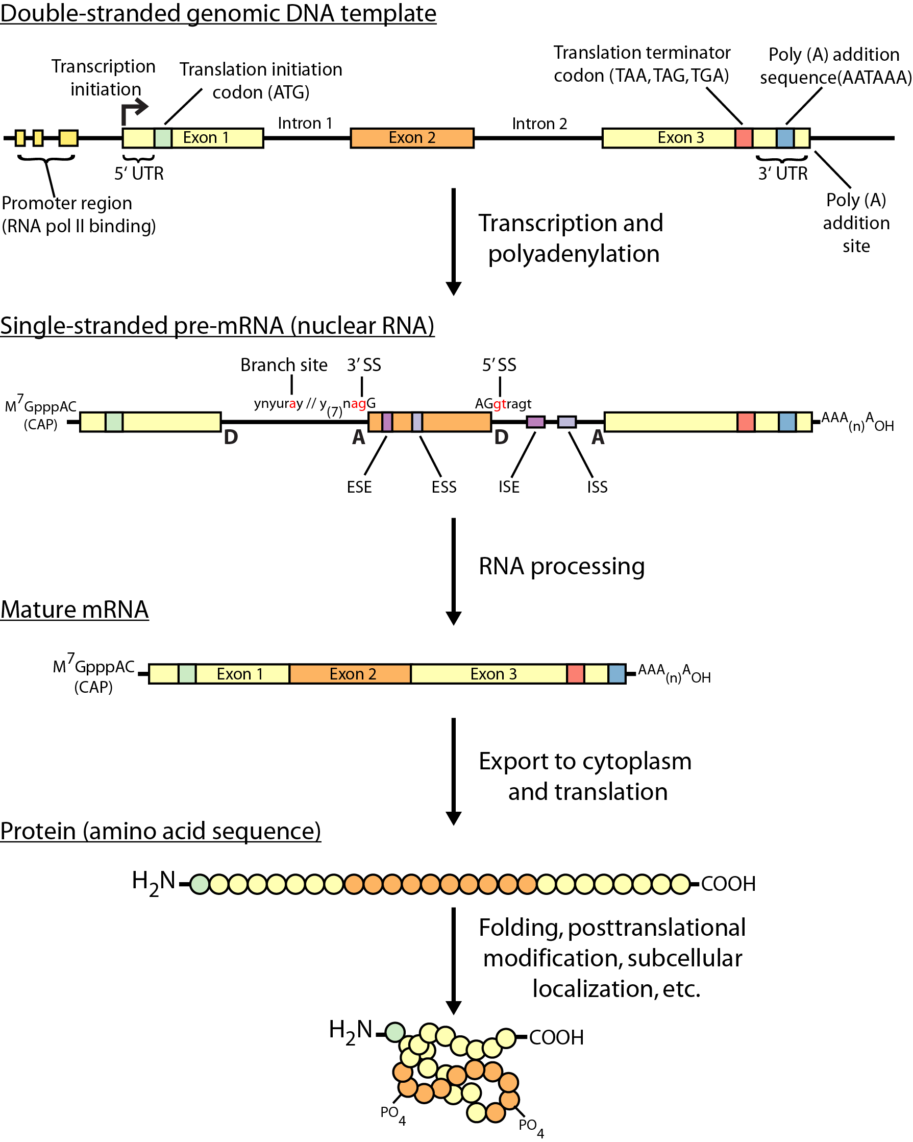
Review of central dogma

Slide 8
‘Omics technologies

Slide 9
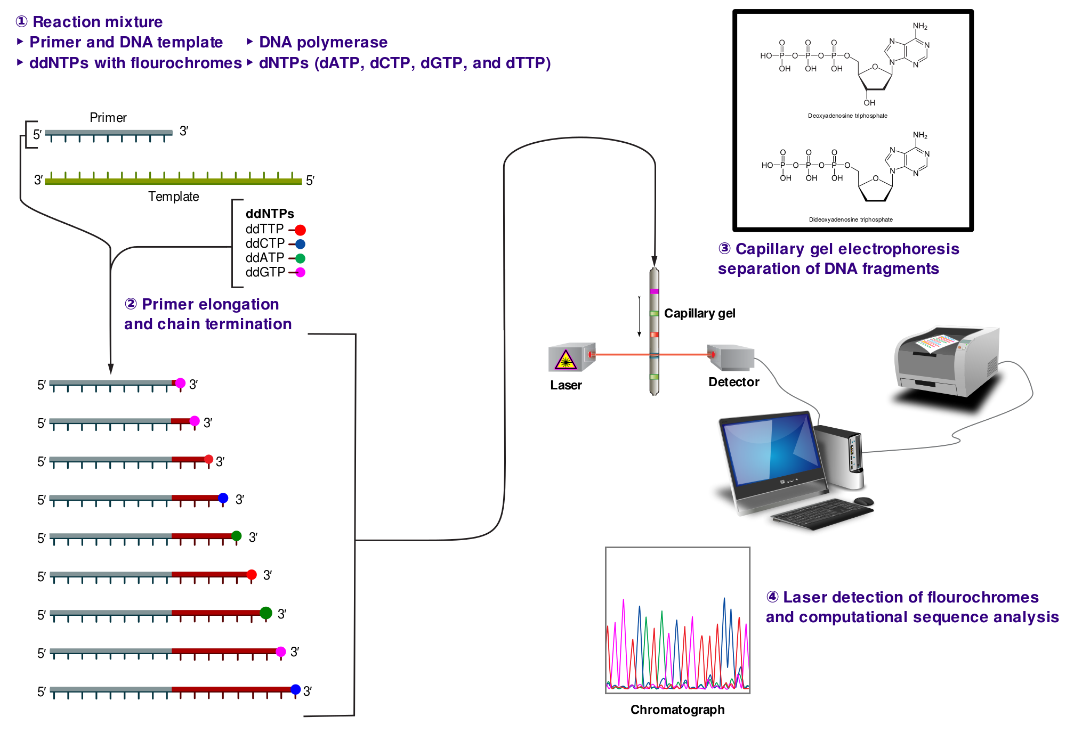
Non-parallel (Sanger) sequencing
Notes:
ddNTP = dideoxy nucleoside triphosphate
dNTP = deoxy nucleoside triphosphate

Slide 10
Non-parallel (Sanger) sequencing
Notes:
ddNTP = dideoxy nucleoside triphosphate
dNTP = deoxy nucleoside triphosphate

Slide 11
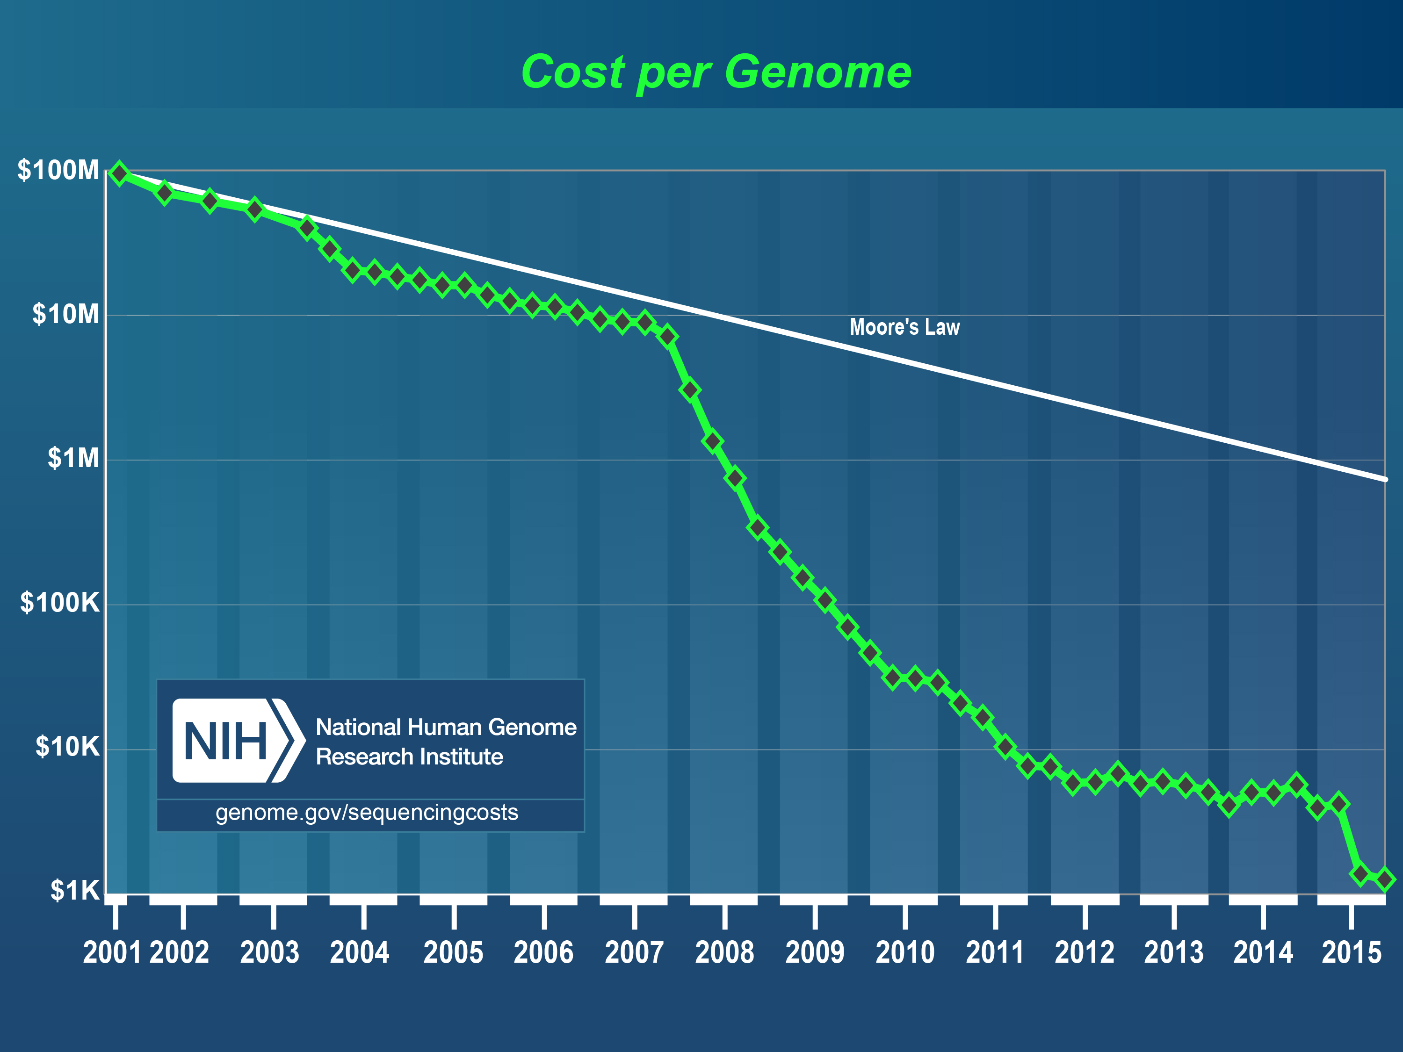
Costs of sequencing a human genome have plummeted from $100M to $1000

Slide 12
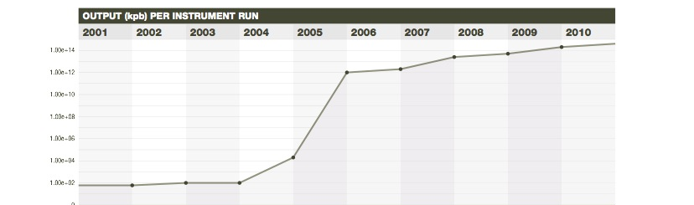
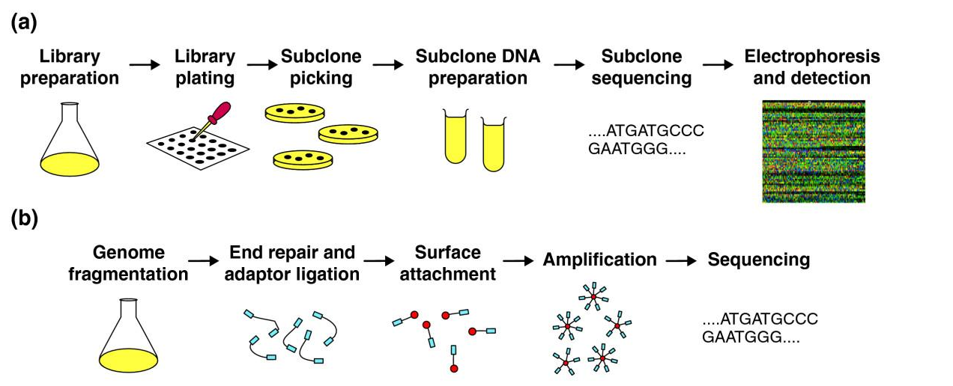
Massively parallel sequencing (NGS) has transformed biomedical inquiry
From 100s of reads to millions+
E.R. Mardis, Nature (2011) 470: 198-203, Ann. Rev. Analyt. Chem. (2013)
Notes:
DNA sequencing capabilities have changed radically since 2005, with the introduction of next-generation or “massively parallel” sequencing instruments. These differ fundamentally from capillary/Sanger methods because the up-front processes required of the latter, such as subcloning, picking of colonies, DNA isolation, and DNA sequencing reaction preparation are no longer needed (top panel). Rather, the massively parallel methods sequence the randomly fragmented, adapter ligated “library” fragments in a stepwise method that intercalates DNA sequencing steps with detection steps. This so-called massively parallel method means that a single human genome can be sequenced in a matter of days to produce the data required to characterize that genome by comparison to the human reference genome.

Slide 13
Massively Parallel DNA sequencing instruments
All MPS platforms require a library obtained either by amplification or ligation with custom linkers (adapters)
Each library fragment is amplified on a solid surface (either bead or flat surface) with covalently attached adapters that hybridize the library adapters
Direct step-by-step detection of the nucleotide base incorporated by each amplified library fragment set
Hundreds of thousands to hundreds of millions of reactions detected per instrument run = “massively parallel sequencing”
A “digital” read type that enables direct quantitative comparisons
Shorter read lengths than capillary sequencers

Slide 14
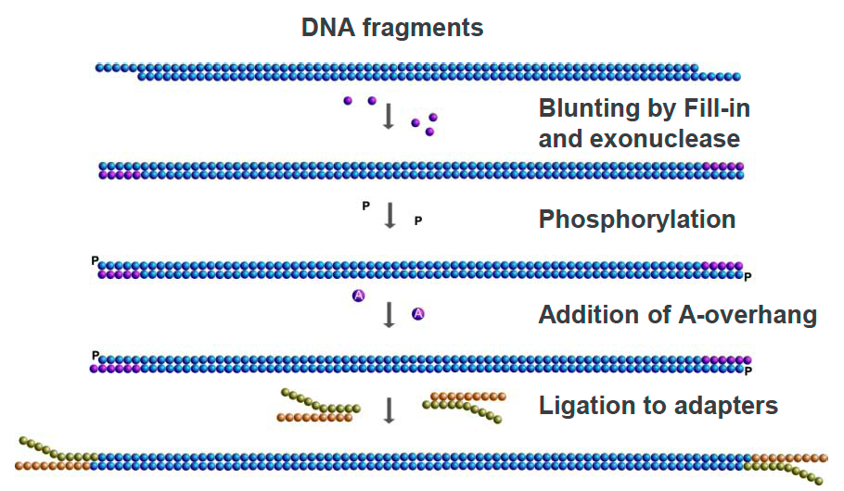
Library Construction for MPS
Shear high molecular weight DNA with sonication
Enzymatic treatments to blunt ends
Ligate synthetic DNA adapters (each with a DNA barcode), PCR amplify
Quantitate library
Proceed to WGS, or perform exome or specific gene hybrid capture

Slide 15
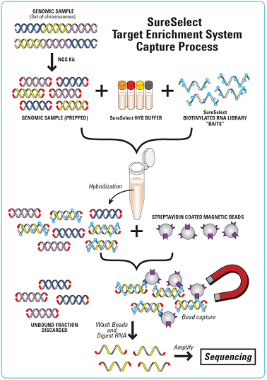
Hybrid Capture
Hybrid capture - fragments from a whole genome library are selected by combining with probes that correspond to most (not all) human exons or gene targets.
The probe DNAs are biotinylated, making selection from solution with streptavidin magnetic beads an effective means of purification.
An “exome” by definition, is the exons of all genes annotated in the reference genome.
Custom capture reagents can be synthesized to target specific loci that may be of clinical interest.

Slide 16
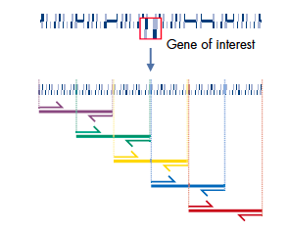
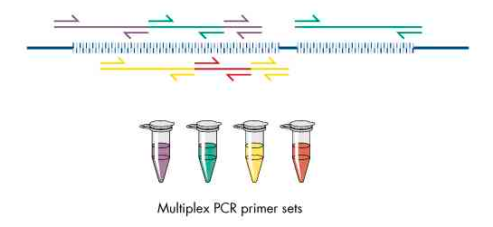
Multiplex PCR Amplification of Targets
Design amplification primer pairs for exons of genes of interest; tile primers to overlap fragments in larger exons
Group primer pairs according to G+C content, Tm and reaction condition specifics
Amplify genomic DNA to generate multiple products from each primer set; pool products from each set
Create library by ligation or tail platform adaptors on the primer ends
Sequence

Slide 17
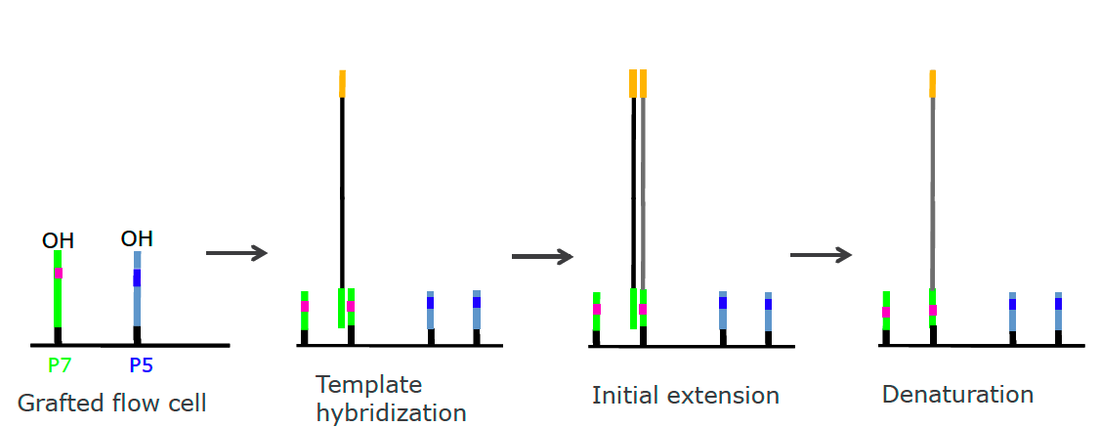
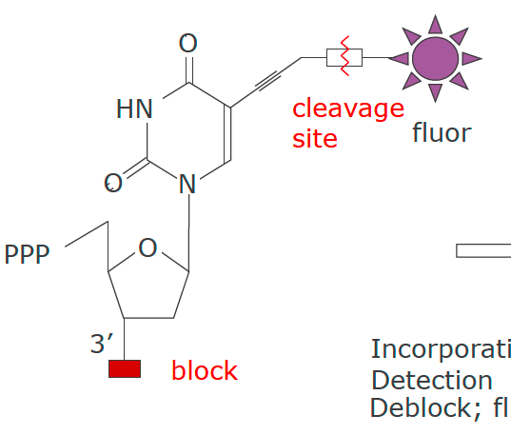
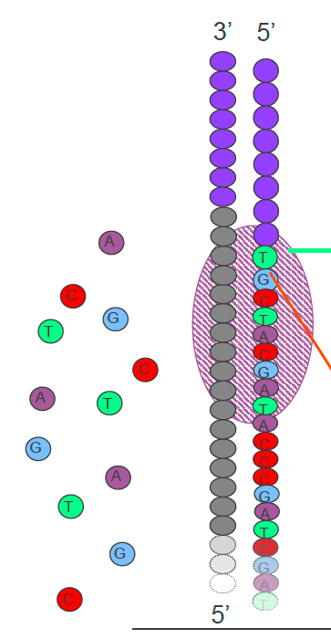
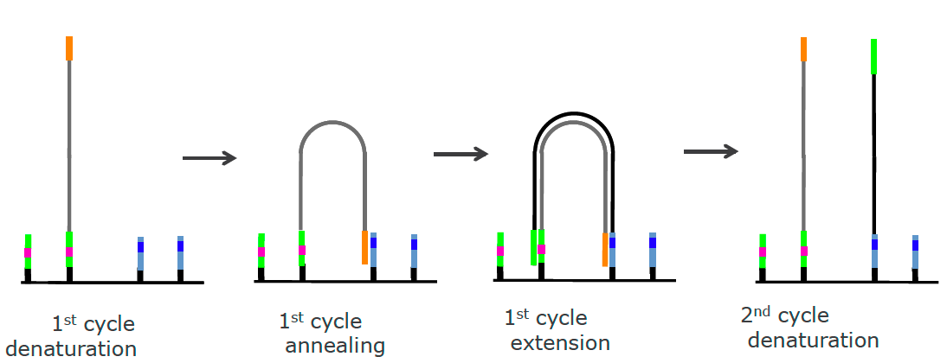
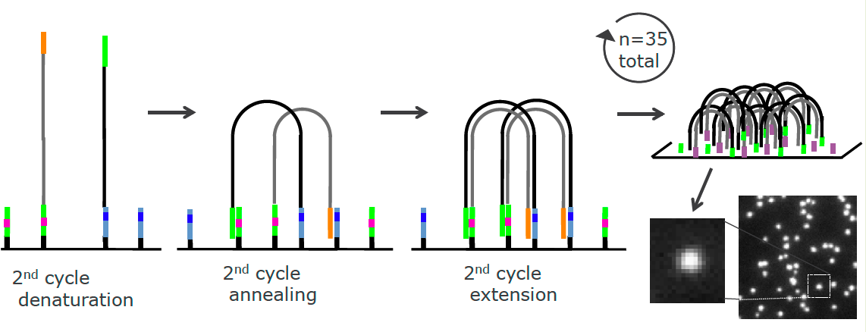
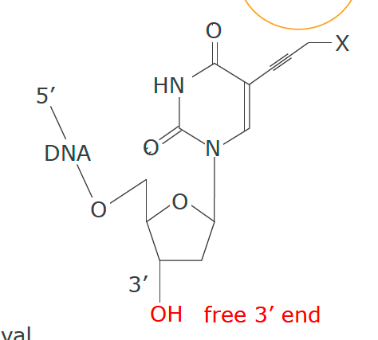
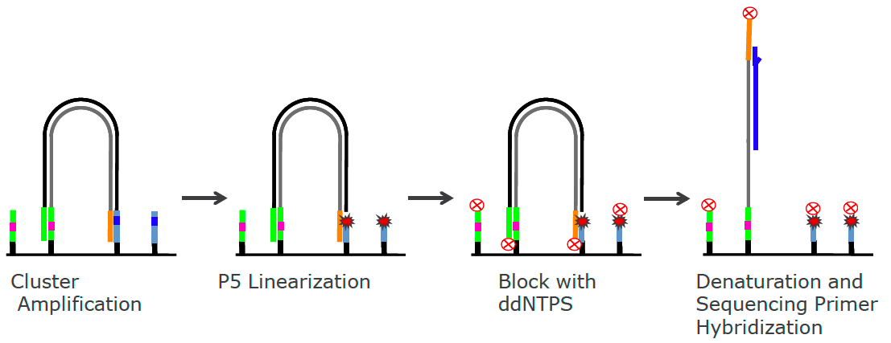
Illumina: Massively Parallel Sequencing by Synthesis
Emission
Incorporate
Detect
De-block
Cleave fluor
Excitation
Additional amplification on flowcell to form clusters

Slide 18
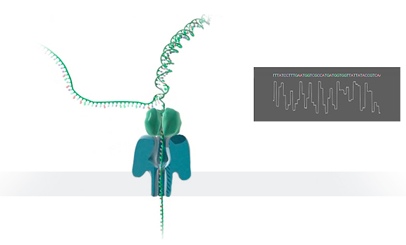
Platforms: Oxford Nanopore Sequencing
Protein nanopore set in an electrically
resistant polymer membrane
Each nanopore is controlled and measured
by a matched ASIC (Application Specific
Integrated Circuit)
Post-run data analysis compares pore current changes to a model of all possible multimers
Variable read lengths
Electrical current-based detection of multiplex nucleotides in pore
Error rate is around 10-20% with newest pore/software
Usage to-date is for bacterial and viral genome sequencing, RNA sequencing

Slide 19
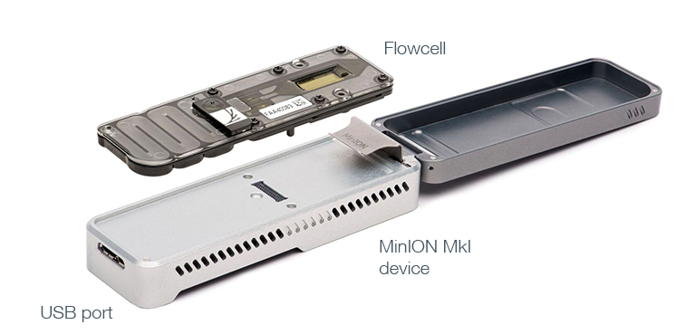
Nanopore Sequencing Devices
Commercially available
$1000 starter pack
512 pores
Simple 10-minute sample prep
10-40k reads
20—100MB per run
Size of a “usb stick”
Long reads (median 1kb, max ~100kb)
Relatively high error rate (38% in 2015)
Improving rapidly with 2D reads and other optimization

Slide 20
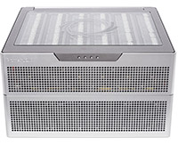
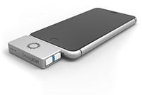
Future nanopore developments
promethION
smidgION
Early access
Price: TBD
48 x 3000 pores
Array of minions
In development
Smart-phone compatible

Slide 21
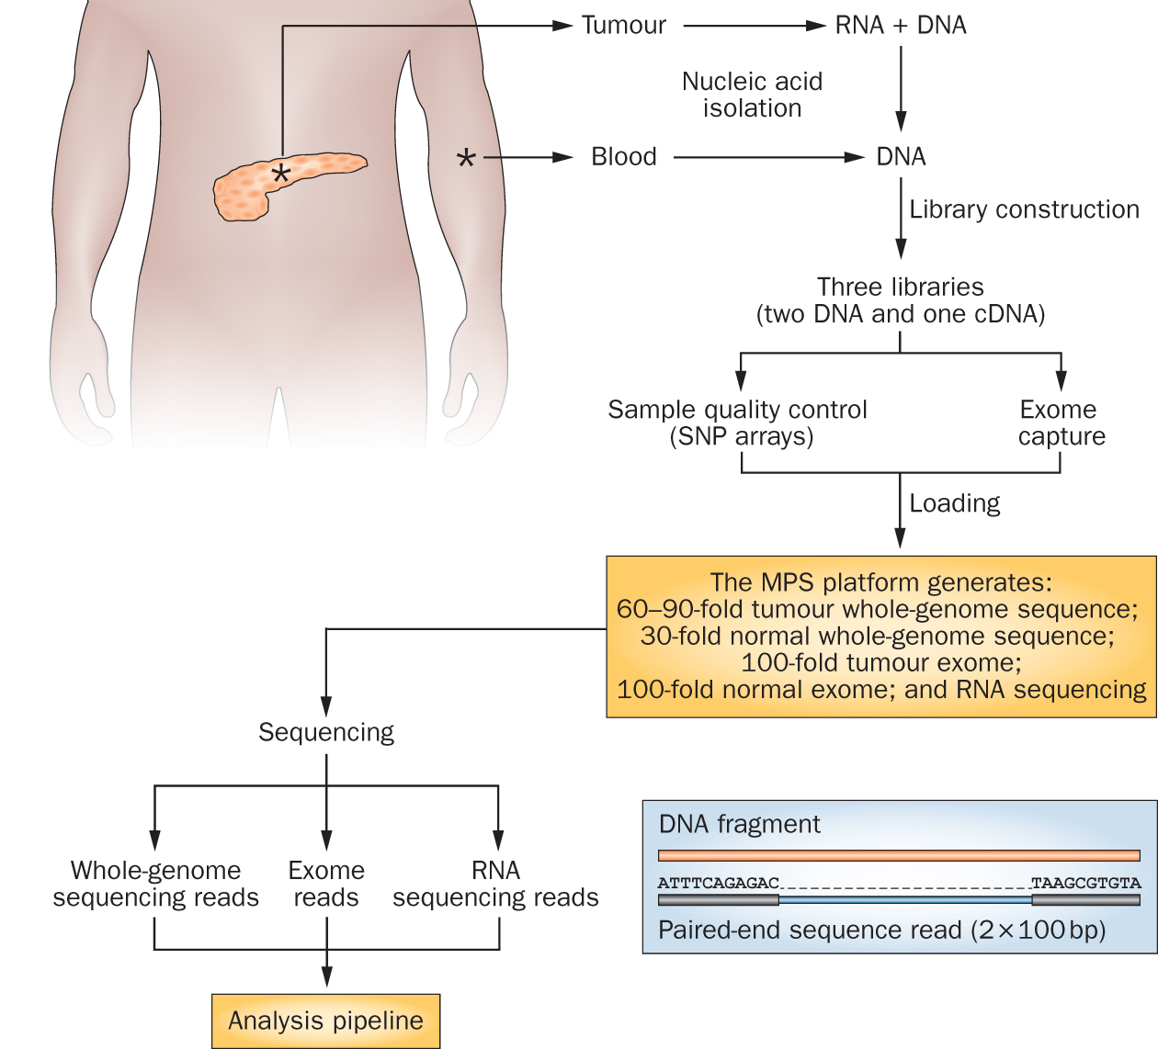
Genomics research has exploded with the rapid advances in DNA sequencing technologies
Notes:
We sequence a lot of things at the Genome Institute. But my research interest is fairly focused on clinical cancer sequencing. The idea here is that we start with a patient, sometimes starting at diagnosis but often starting at the point where they have exhausted standard of care options.
From these patients we get a tumor sample and a reference normal sample (usually blood). From the tumor we isolate DNA and RNA and from the normal we isolated DNA. This trio of samples is subjected to library construction followed by whole genome, exome, and transcriptome sequencing. This data flows into our analysis systems and we attempt to detect somatic events that might be relevant to cancer biology or treatment. This involves detecting single nucleotide variants, small insertions and deletions, large copy number amplifications and deletions, gene and isoform expression levels, structure rearrangements, expressed gene fusions, and detection of tumor associated viruses.

Slide 22

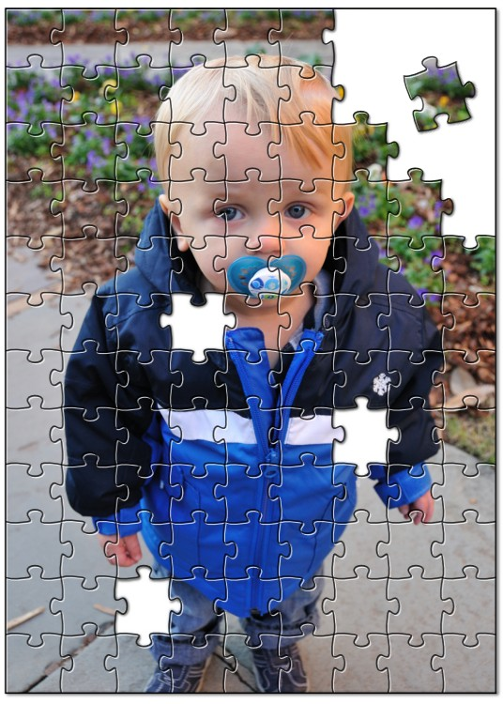
Short read alignments – The fundamental unit of most omics assays
Alignment is about fitting individual pieces (reads) into the correct part of the puzzle
The human genome project gave us the picture on the box cover (the reference genome)
Imperfections in how the pieces fit can indicate changes to a copy of the picture
AGCCTGAGACCGTAAAAAAGTCAAG
|||||||||||||||||
GAGACCGTAAAAACGTC
Reference:
A read sequence:
A variant!

Slide 23
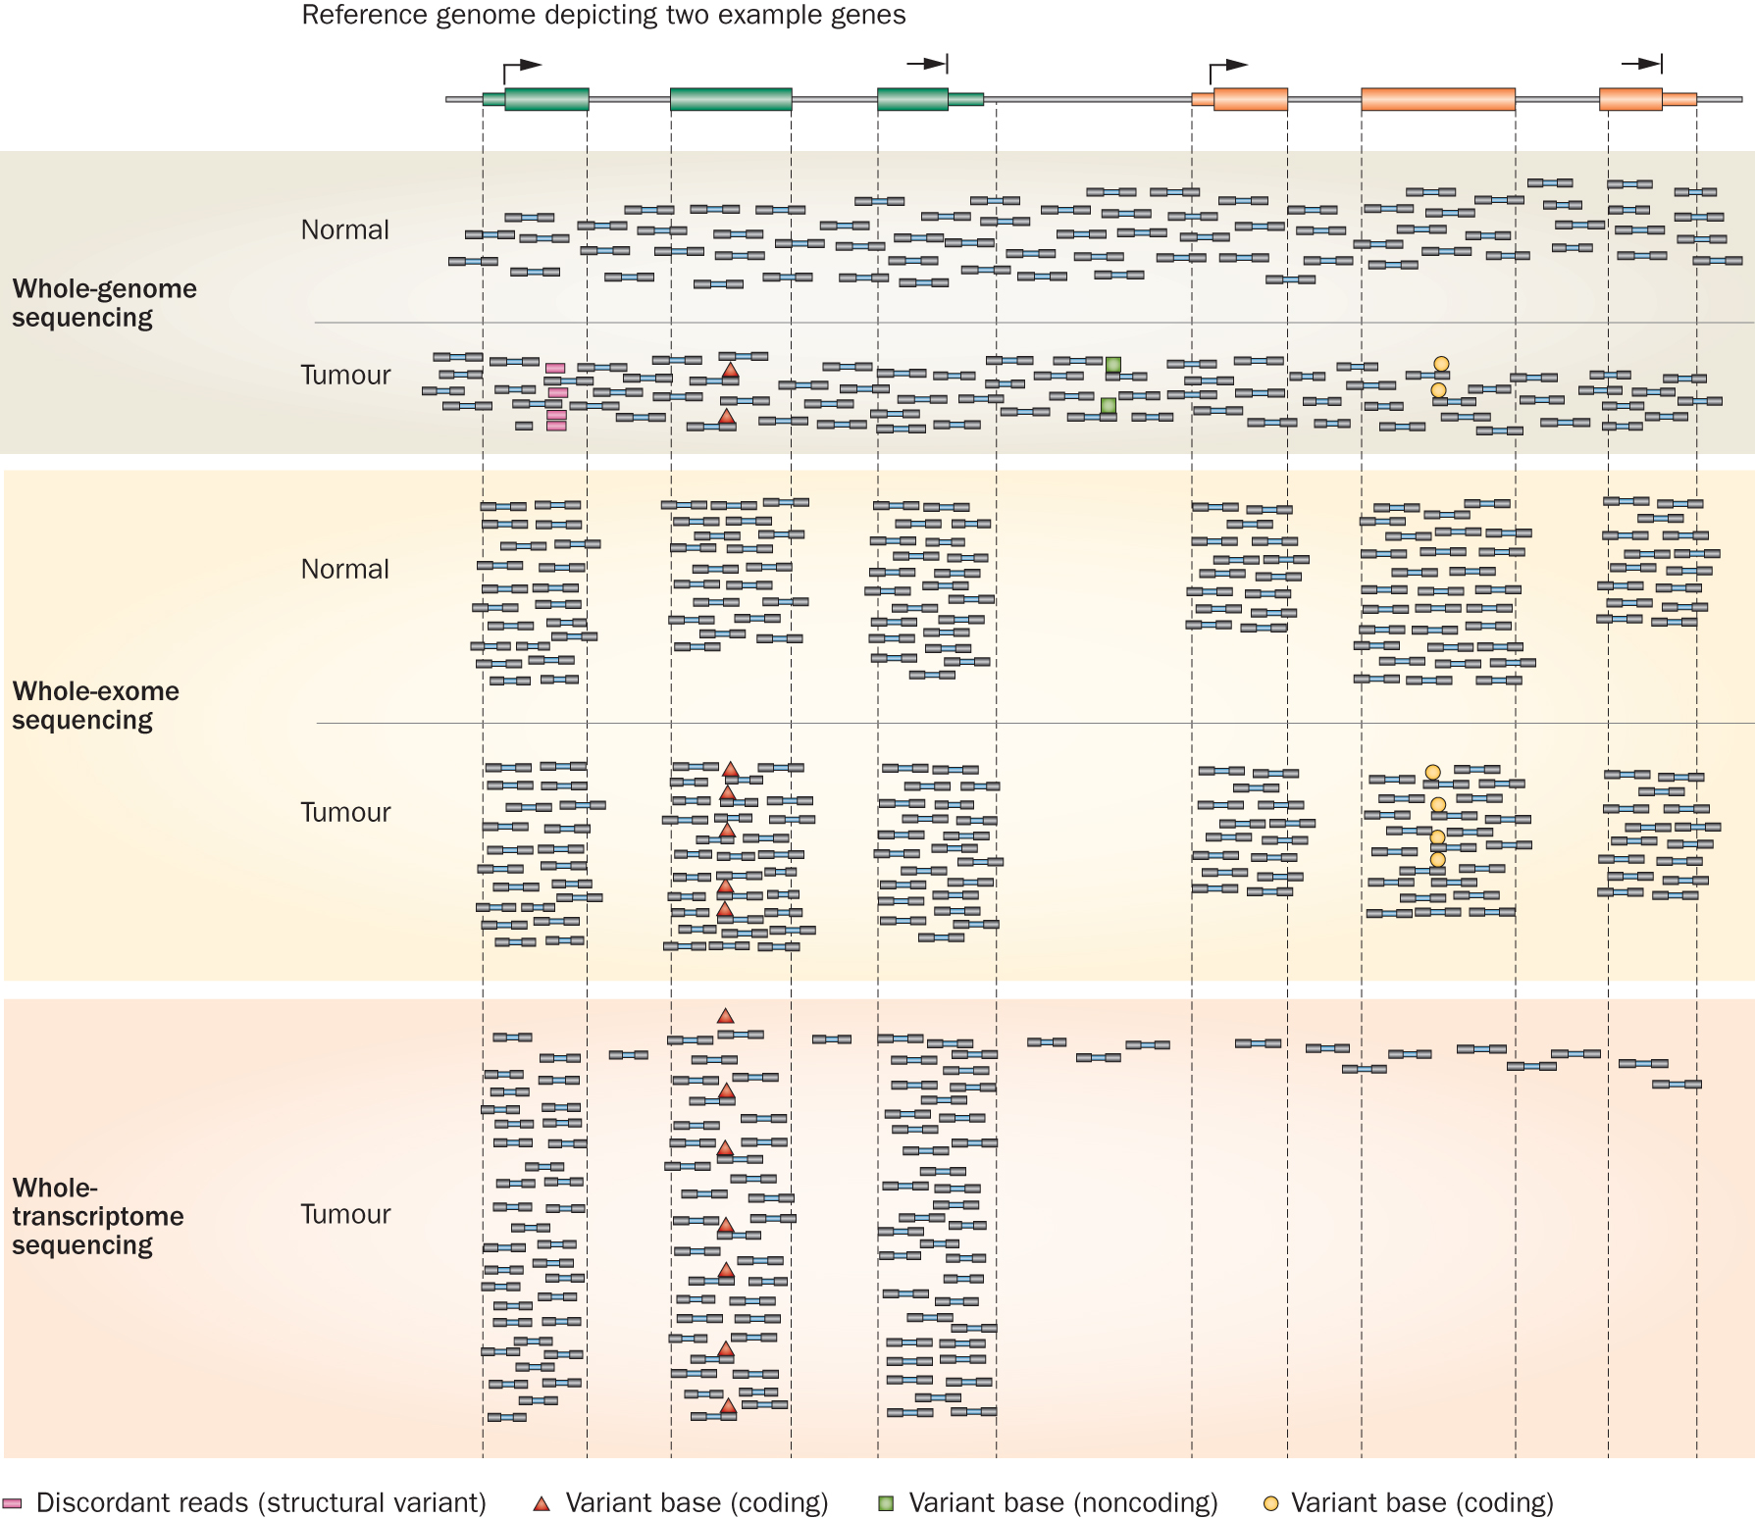
Whole genome, exome and transcriptome sequencing allows us to detect and confirm many different variant types
‘WGS’
‘Exome’
‘RNA-seq’
Notes:
Each of these three data types, whole genome, exome and transcriptome, brings something to the table.
Whole genome gives you broad, even, and relatively unbiased coverage across the genome.
Exome gives you more focused coverage but much greater depth over the exons for a much lower cost than whole genome
RNA-seq gives you a snapshot of the transcriptome.

Slide 24
Common genomic file formats

Slide 25
Common genomic data file formats
FASTA
FASTQ
GTF
BED
VCF
VEP
MAF
SAM/BAM/CRAM
Many, many custom data formats output by specialized tools … often in TSV format

Slide 26
Fasta – format for representing nucleic acid or amino acid sequences
First line starts with “>” header or ”Comment”; used as a summary/description, often starting with unique accession/identifier
>AY274119.3 Severe acute respiratory syndrome-related coronavirus isolate Tor2, complete genome
ATATTAGGTTTTTACCTACCCAGGAAAAGCCAACCAACCTCGATCTCTTGTAGATCTGTTCTCTAAACGA
ACTTTAAAATCTGTGTAGCTGTCGCTCGGCTGCATGCCTAGTGCACCTACGCAGTATAAACAATAATAAA
TTTTACTGTCGTTGACAAGAAACGAGTAACTCGTCCCTCTTCTGCAGACTGCTTACGGTTTCGTCCGTGT
TGCAGTCGATCATCAGCATACCTAGGTTTCGTCCGGGTGTGACCGAAAGGTAAGATGGAGAGCCTTGTTC
TTGGTGTCAACGAGAAAACACACGTCCAACTCAGTTTGCCTGTCCTTCAGGTTAGAGACGTGCTAGTGCG
TGGCTTCGGGGACTCTGTGGAAGAGGCCCTATCGGAGGCACGTGAACACCTCAAAAATGGCACTTGTGGT
…
>FJ882960.1 SARS coronavirus ExoN1 isolate P3pp34, complete genome
CGATCTCTTGTAGATCTGTTCTCTAAACGAACTTTAAAATCTGTGTAGCTGTCGCTCGGCTGCATGCCTA
GTGCACCTACGCAGTATAAACAATAATAAATTTTACTGTCGTTGACAAGAAACGAGTAACTCGTCCCTCT
TCTGCAGACTGCTTACGGTTTCGTCCGTGTTGCAGTCGATCATCAGCATACCTAGGTTTCGTCCGGGTGT
…
Subsequent lines contain sequence
Interleaved: sequence broken into multiple lines of characters
Sequential: entire sequence on a single line
Multiple sequence FASTA obtained by simply concatenating multiple FASTA records together

Slide 27
Fastq – format for representing raw sequence – base calls and quality values
First line starts with “@” header or ”Comment”; followed by sequence identifier and optional description
@HWUSI-EAS100R:6:73:941:1973#0/1
CTTTTTTATTTTTGTCTGACTGGGTTGATTCAAAA
+
CCCFFFFFHHHHGJHIIJHIHIIIFHIJJJJIJJGIBBFGE
@HWUSI-EAS100R:6:2303:11793:37095#0/1
ATGAATTATAGGGCTGTATTTTAATTTTGCATTTTAA
+
@@??BDDFFF<FHEGFFGGIEBGHIIIIIBEHIIGIH<FHE
Sequence line
Spacer line
Quality values
Next sequence record

Slide 28
Read naming conventions
@HWUSI-EAS100R:6:73:941:1973#0/1
Instrument ID
Tile
Index
Lane
X/Y coords
Pair
Filter status
@EAS139:136:FC706VJ:2:2104:15343:197393:GATTACT+GTCTTAAC 1:Y:0:ATCACG
Instrument ID
Flowcell
tile
UMI
Control #
Run
lane
x/y coords
Pair
Index

Slide 29
Quality values - Phred scores and ASCII glyphs
Phred Q | Probability (P) of Wrong Base | Base Call Accuracy | Sanger “Q + 33” Shift | Sanger “Q + 33” Shift ASCII glyph
0 | 1 | 0 | 33 | !
1 | 0.794 | 0.206 | 34 | “
2 | 0.631 | 0.369 | 35 | #
10 | 0.1 | 0.9 | 43 | +
20 | 0.01 | 0.99 | 53 | 5
30 | 0.001 | 0.999 | 63 | ?
Encoding History:
Sanger Format (shown above): Q of 0 to 93 using ASCII 33 to 126
Sanger data, SAM format, Illumina 1.8+
Solexa/Illumina 1.0: Q of -5 to 62 using ASCII 59 to 126
Illumina 1.3 to 1.8: Q of 0 to 62 using ASCII 64 to 126
Illumina 1.5 to 1.7: Phred scores 0 to 2 have a slightly different meaning
Illumina 1.8+ -> Sanger Format
Notes:
http://www.somewhereville.com/2011/12/16/sanger-and-illumina-1-3-and-solexa-phred-score-q-ascii-glyph-base-error-conversion-tables/
https://en.wikipedia.org/wiki/FASTQ_format#Quality

Slide 30
GFF/GTF - representing sequence features
GFF – General/Generic Feature Format; Gene Finding Format
Two versions in wide use
GFF2 (see also GTF)
GFF3
Added formal support for multiple levels (and direction) of hierarchy (e.g., gene -> transcript -> exon)
GTF – Gene Transfer Format
An extension of GFF2
GFF2, GFF3 and GTF are all tab-separate files with 9 fields
Differing content in 9th column

Slide 31
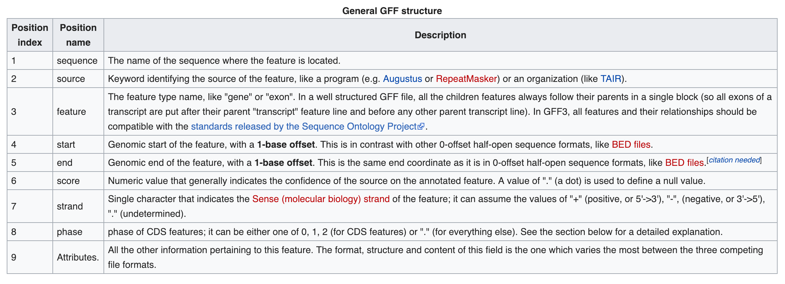
GFF/GTF – general structure
https://en.wikipedia.org/wiki/General_feature_format
Notes:
https://en.wikipedia.org/wiki/General_feature_format

Slide 32
Ensembl GTF example record
22 ensembl start_codon 11066501 11066503 . + 0 gene_id "ENSG00000279973”; …
Sequence Name
Feature
End
Strand
Attributes
Source
Start
Score
Phase/Frame
Example of attributes string:
gene_id "ENSG00000279973”; gene_version "1"; transcript_id "ENST00000624155"; transcript_version "1"; exon_number "1"; gene_name "BAGE5"; gene_source "ensembl"; gene_biotype "protein_coding"; transcript_name "BAGE5-201"; transcript_source "ensembl"; transcript_biotype "protein_coding"; tag "basic"; transcript_support_level "1";
Note: there will be many GTF records/rows per transcript per gene (UTRs, start_codon, exons, etc)
Notes:
gene_id "ENSG00000279973”; gene_version "1"; transcript_id "ENST00000624155"; transcript_version "1"; exon_number "1"; gene_name "BAGE5"; gene_source "ensembl"; gene_biotype "protein_coding"; transcript_name "BAGE5-201"; transcript_source "ensembl"; transcript_biotype "protein_coding"; tag "basic"; transcript_support_level "1";

Slide 33
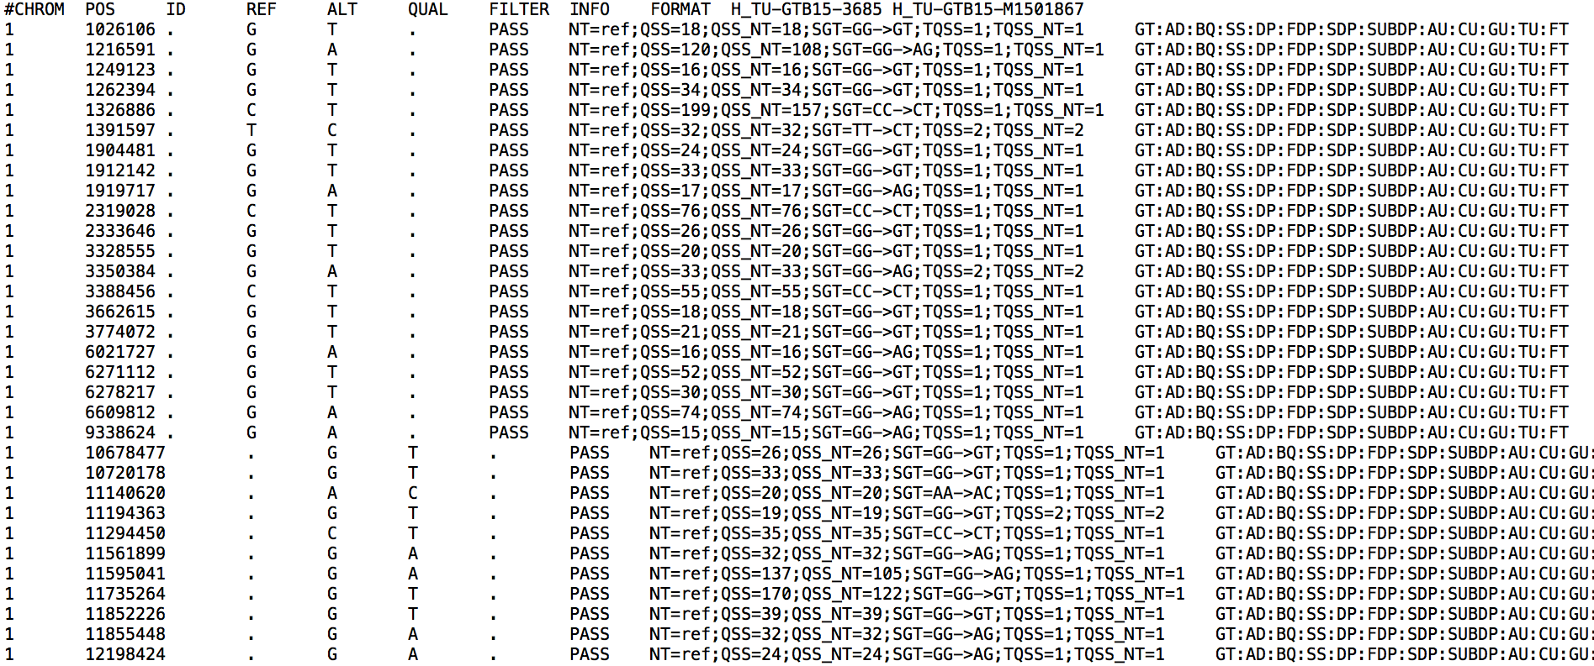
VCF file
Details of the VCF file format: hts-specs, VCF-v4.2.pdf

Slide 34
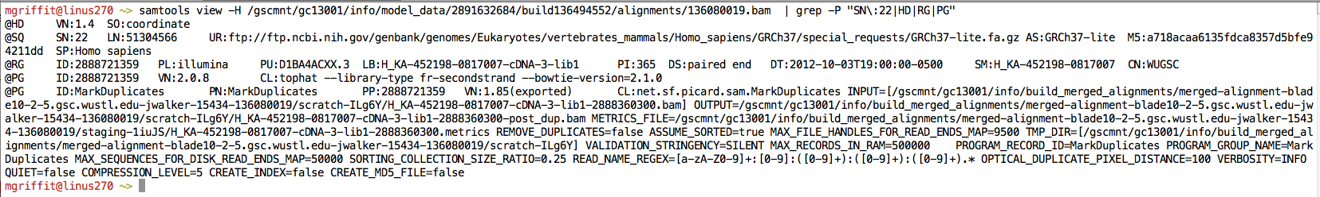
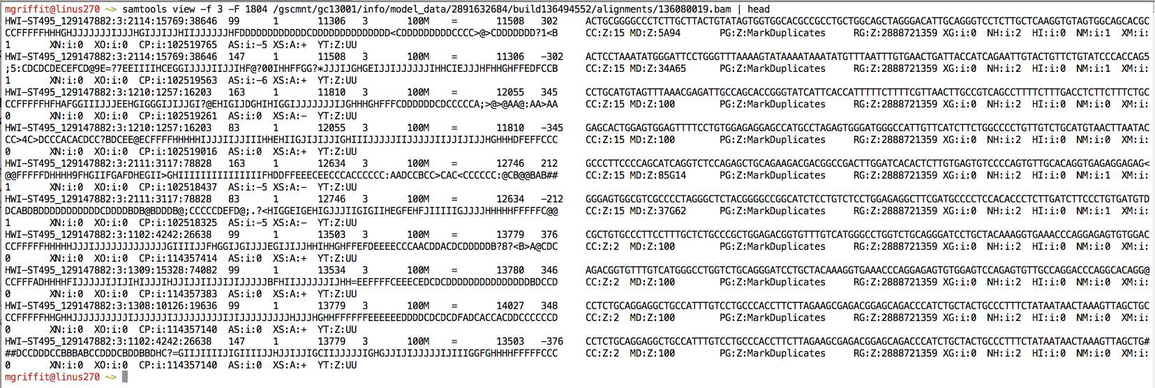
Example of SAM/BAM file format
Example SAM/BAM header section (abbreviated)
Example SAM/BAM alignment section (only 10 alignments shown)

Slide 35
Introduction to the SAM/BAM format
The specification
http://samtools.sourceforge.net/SAM1.pdf
The SAM format consists of two sections:
Header section
Used to describe source of data, reference sequence, method of alignment, etc.
Alignment section
Used to describe the read, quality of the read, and nature alignment of the read to a region of the genome
BAM is a compressed version of SAM
Compressed using lossless BGZF format
Other BAM compression strategies are a subject of research. See ‘CRAM’ format for example
BAM files are usually ‘indexed’
A ‘.bai’ file will be found beside the ‘.bam’ file
Indexing aims to achieve fast retrieval of alignments overlapping a specified region without going through the whole alignments. BAM must be sorted by the reference ID and then the leftmost coordinate before indexing

Slide 36
SAM/BAM header section
Used to describe source of data, reference sequence, method of alignment, etc.
Each section begins with character ‘@’ followed by a two-letter record type code. These are followed by two-letter tags and values
@HD The header line
VN: format version
SO: Sorting order of alignments
@SQ Reference sequence dictionary
SN: reference sequence name
LN: reference sequence length
SP: species
@RG Read group
ID: read group identifier
CN: name of sequencing center
SM: sample name
@PG Program
PN: program name
VN: program version

Slide 37
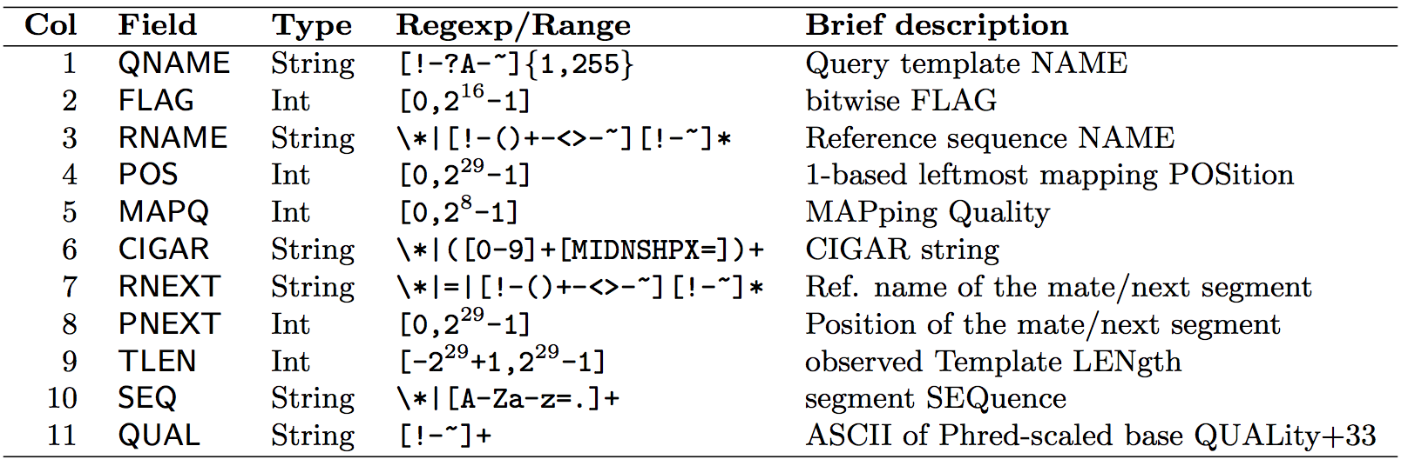
SAM/BAM alignment section
Example values
QNAME e.g. HWI-ST495_129147882:1:2302:10269:12362 (QNAME)
FLAG e.g. 99
RNAME e.g. 1
POS e.g. 11623
MAPQ e.g. 3
CIGAR e.g. 100M
RNEXT e.g. =
PNEXT e.g. 11740
TLEN e.g. 217
SEQ e.g. CCTGTTTCTCCACAAAGTGTTTACTTTTGGATTTTTGCCAGTCTAACAGGTGAAGCCCTGGAGATTCTTATTAGTGATTTGGGCTGGGGCCTGGCCATGT
QUAL e.g. CCCFFFFFHHHHHJJIJFIJJJJJJJJJJJHIJJJJJJJIJJJJJGGHIJHIJJJJJJJJJGHGGIJJJJJJIJEEHHHHFFFFCDCDDDDDDDB@ACDD

Slide 38
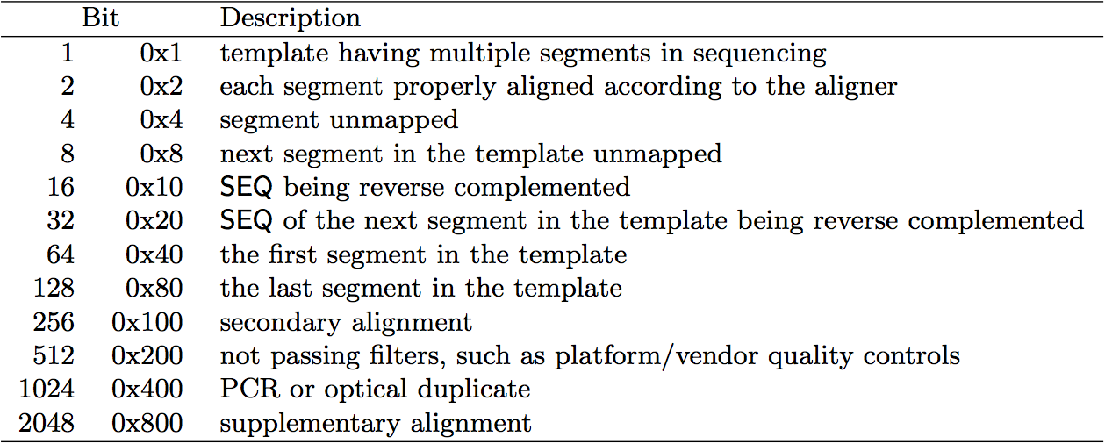
SAM/BAM flags explained
http://broadinstitute.github.io/picard/explain-flags.html
12 bitwise flags describing the alignment
These flags are stored as a binary string of length 11 instead of 11 columns of data
Value of ‘1’ indicates the flag is set. e.g. 00100000000
All combinations can be represented as a number from 1 to 2048 (i.e. 2¹¹-1). This number is used in the BAM/SAM file. You can specify ‘required’ or ‘filter’ flags in samtools view using the ‘-f’ and ‘-F’ options respectively
Note that to maximize confusion, each bit is described in the SAM specification using its hexadecimal representation (i.e., '0x10' = 16 and '0x40' = 64).

Slide 39
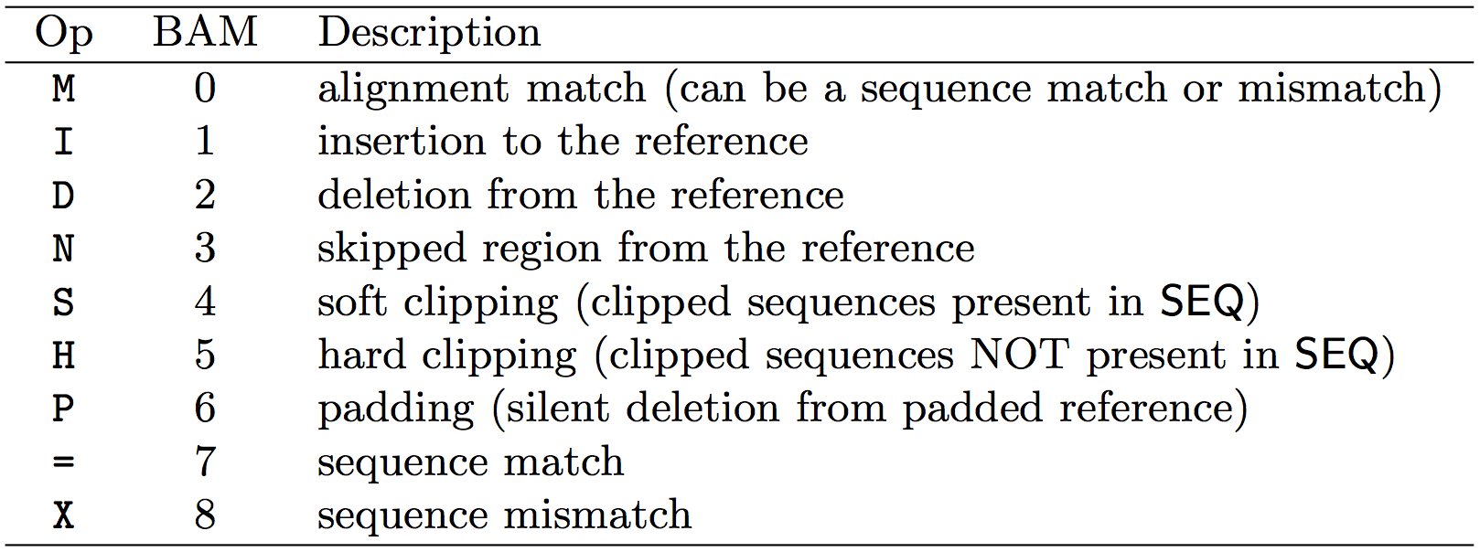
CIGAR strings explained
The CIGAR string is a sequence of base lengths and associated ‘operations’ that are used to indicate which bases align to the reference (either a match or mismatch), are deleted, are inserted, represent introns, etc.
e.g. 81M859N19M
A 100 bp read consists of: 81 bases of alignment to reference, 859 bases skipped (an intron), 19 bases of alignment

Slide 40
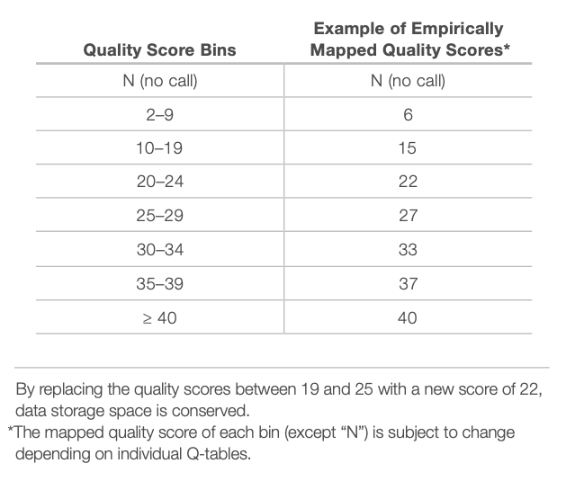
CRAM files
CRAM is an ultra-compressed version of a BAM file
Usually between 30-60% smaller than the corresponding BAM
Stores “diffs” from the reference genome
requires the matching reference genome to restore original data!
Base quality binning may be used as well
Some tools still require conversion back to bam

Slide 41
Introduction to the BED format
When working with BAM files, it is very common to want to examine a focused subset of the reference genome
e.g. the exons of a gene
These subsets are commonly specified in ‘BED’ files
https://genome.ucsc.edu/FAQ/FAQformat.html#format1
Many BAM manipulation tools accept regions of interest in BED format
Basic BED format (tab separated):
Chromosome name, start position, end position
Coordinates in BED format are 0 based

Slide 42

Manipulation of SAM/BAM and BED files
Several tools are used ubiquitously in sequence analysis to manipulate these files
SAM/BAM files
samtools
bamtools
picard
BED files
bedtools
bedops

Slide 43
Common problems

Slide 44
Common sources of confusion
Genomic coordinate systems
Genome builds
Variant representation

Slide 45
Genomic coordinates – 1 vs 0 based
chr1 |  | T |  | A |  | C |  | G |  | T |  | C |  | A
1-based |  | 1 |  | 2 |  | 3 |  | 4 |  | 5 |  | 6 |  | 7
0-based | 0 |  | 1 |  | 2 |  | 3 |  | 4 |  | 5 |  | 6 |  | 7
 | 1-based | 0-based
Indicate a single nucleotide | chr1:4-4 G | chr1:3-4 G
Indicate a range of nucleotides | chr1:2-4 ACG | chr1:1-4 ACG
Indicate a single nucleotide variant | chr1:5-5 T/A | chr1:4-5 T/A
1-based : Single nucleotides, variant positions, or ranges are specified directly by their corresponding nucleotide numbers
GFF, SAM, VCF, Ensembl browser, …
0-based: Single nucleotides, variant positions, or ranges are specified by the coordinates that flank them
BED, BAM, UCSC browser, …

Slide 46
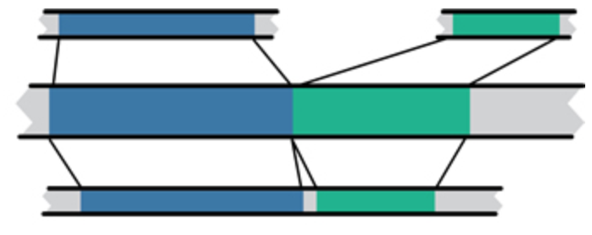
Genome builds
Reference Genome builds
Current human: GRCh38, hg38, b38
alternate: GRCh38v2_ccdg Previous human: GRCh37, hg19, b37 Current mouse: GRCm38, mm10
Lift-over
Mouse mm10
Human hg19
Human GRCh37

Slide 47
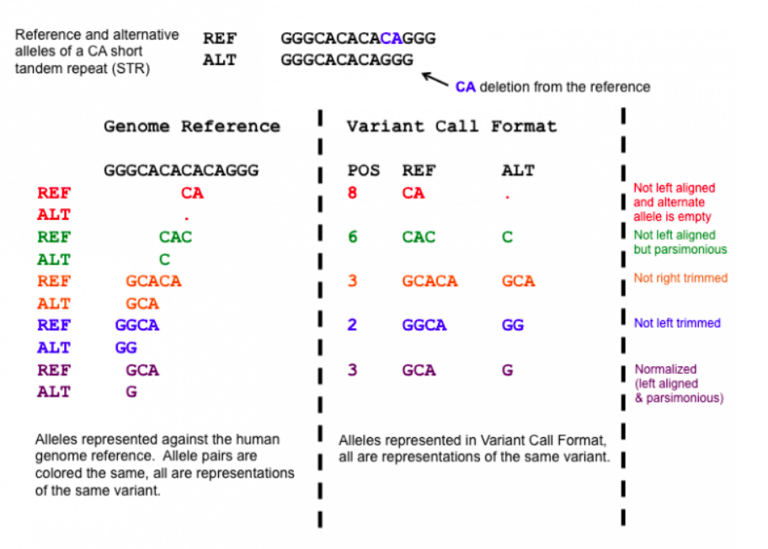
Variant shifting (alignment) and parsimony/trimming
Parsimony: representing variant in as few nucleotides as possible without reducing the length of any allele to 0
Left (right) aligning = shifting the start position of a variant as far to the left (right) as possible
Notes:
https://genome.sph.umich.edu/wiki/Variant_Normalization
Parsimony means representing a variant in as few nucleotides as possible without reducing the length of any allele to 0.
Left aligning a variant means shifting the start position of that variant to the left till it is no longer possible to do so.
The representation of variants in a VCF file requires that no alleles in the REF and ALT field are represented with an empty string (empty allele). The red indel has an illegal VCF representation.
The green variant is not left aligned as you can prefix an A nucleotide on the left side of the variant's alleles and truncate the C on the right side of the variant's alleles. It is however parsimonious.
The orange variant is left aligned but is not right parsimonious.
The blue variant is left aligned but not left parsimonious.
The maroon variant is left aligned and parsimonious.

Slide 48
How should I sort my SAM/BAM file?
Generally BAM files are sorted by position
This is for performance reasons
When sorted and indexed, arbitrary positions in a massive BAM file can be accessed rapidly
Certain tools require a BAM sorted by read name
Usually this is when we need to easily identify both reads of a pair
The insert size between two reads may be large
In fusion detection we are interested in read pairs that map to different chromosomes

Slide 49
Genome browsers

Slide 50
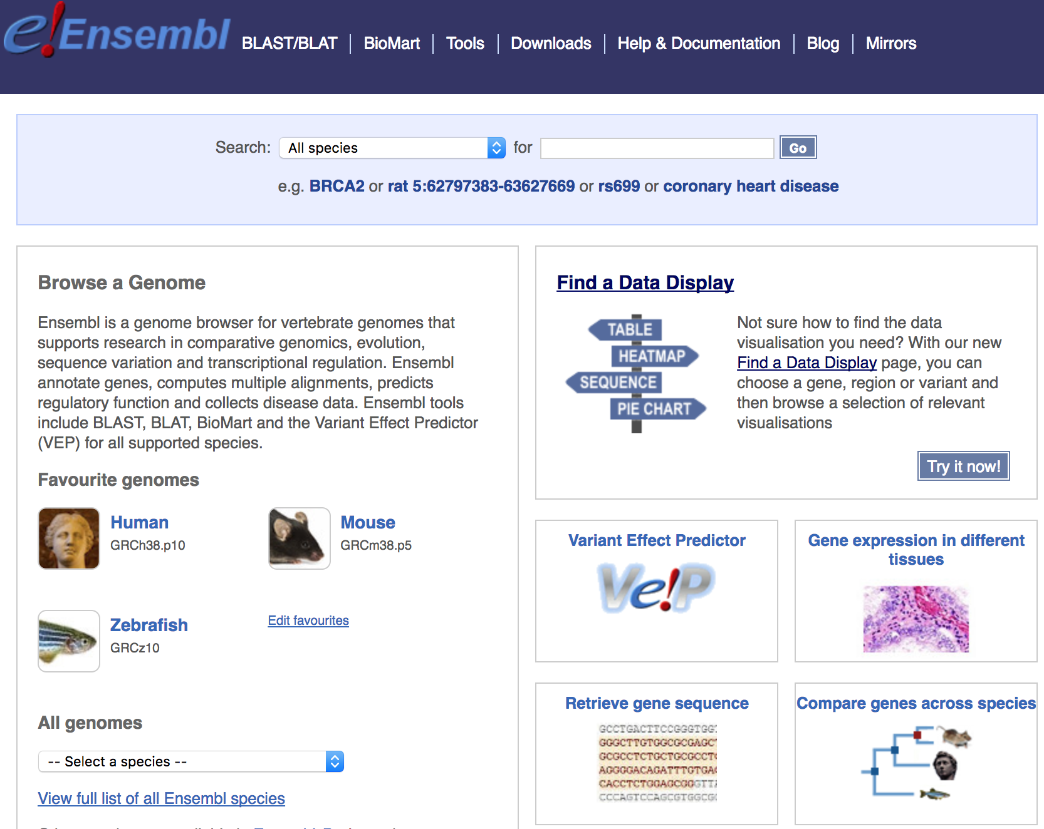
Genome browsers - Ensembl

Slide 51
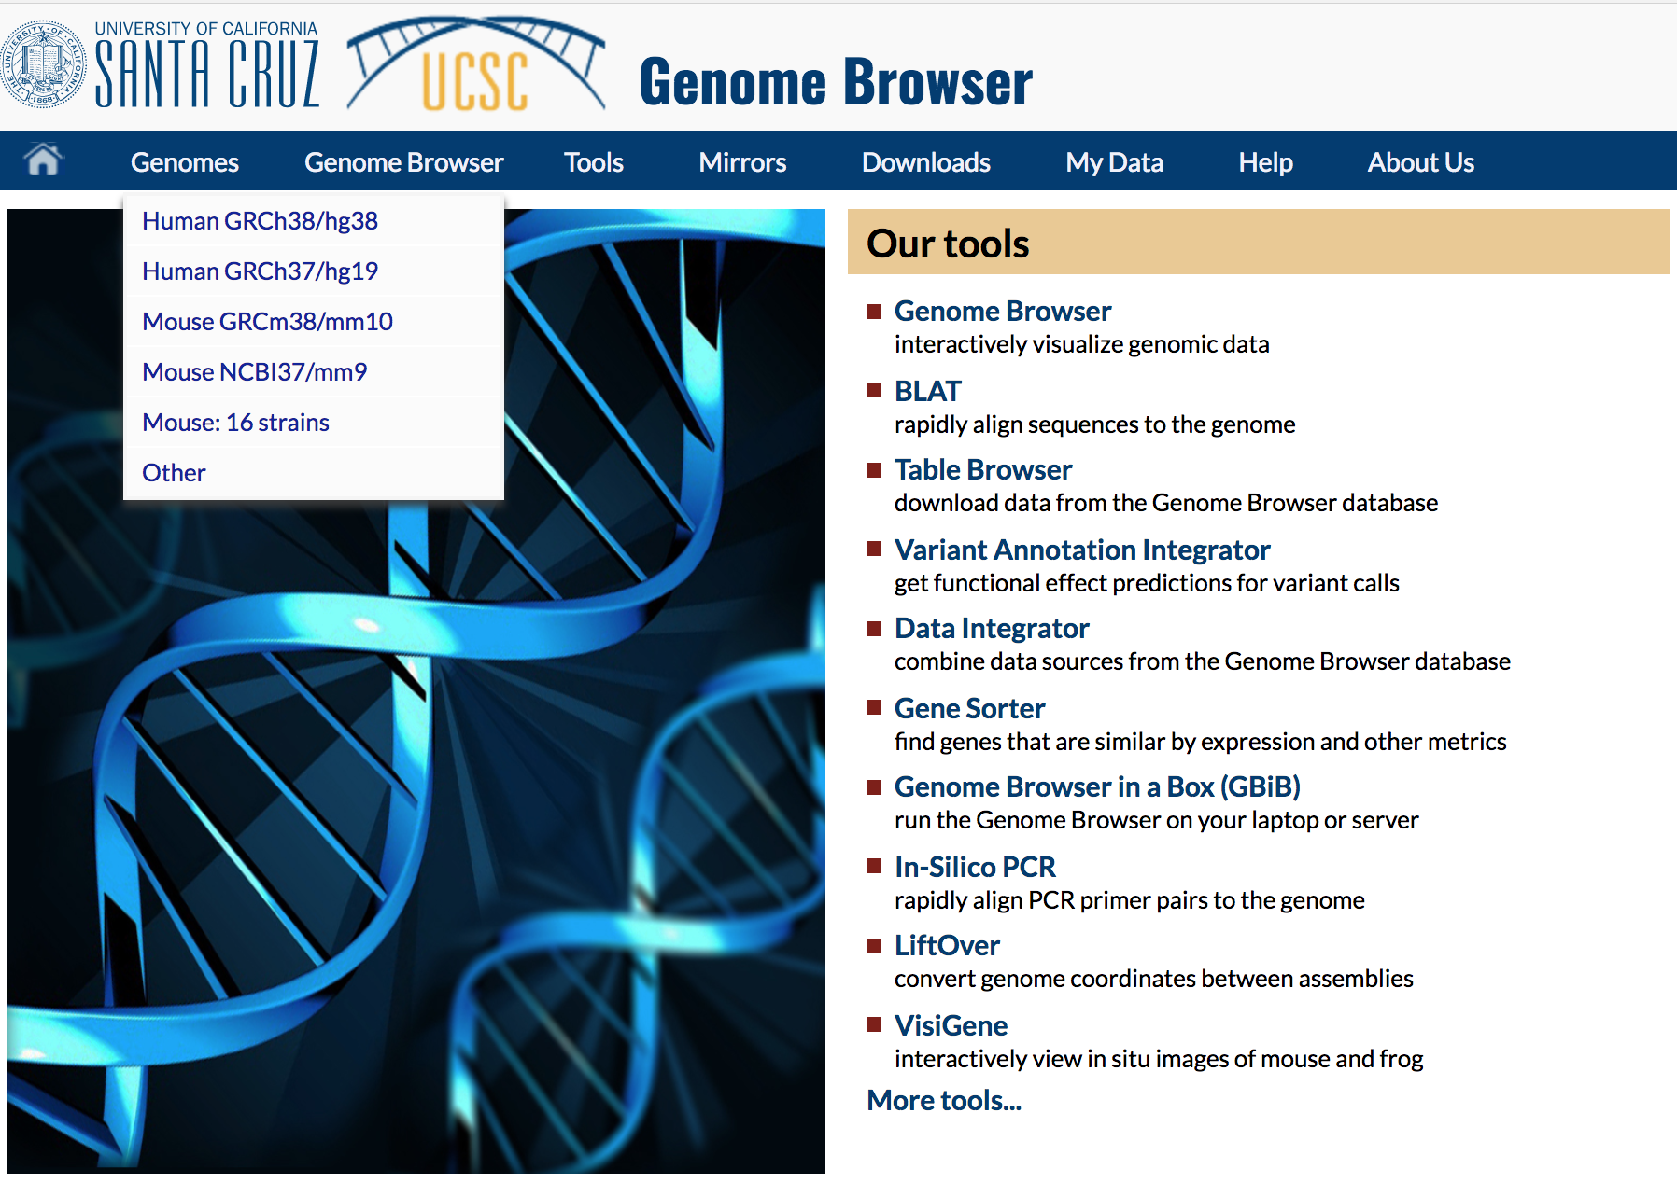
Genome browsers - UCSC

Slide 52
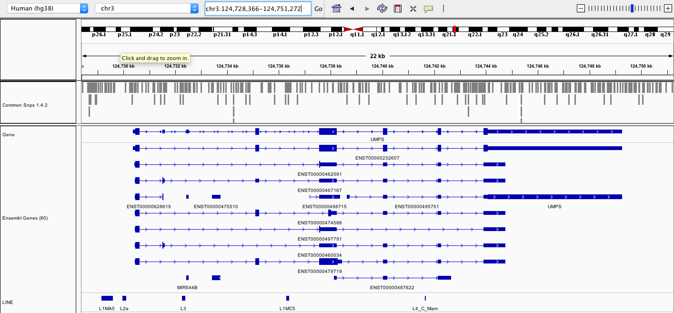
Genome browsers - IGV

Slide 53
Fundamentals of data visualization

Slide 54
Fundamentals of data visualization
Where to learn more about the art and science of visualization:
Collection of 40 Nature Methods articles on data visualization: “Points of View” Articles
Visual design principles lecture

Slide 55
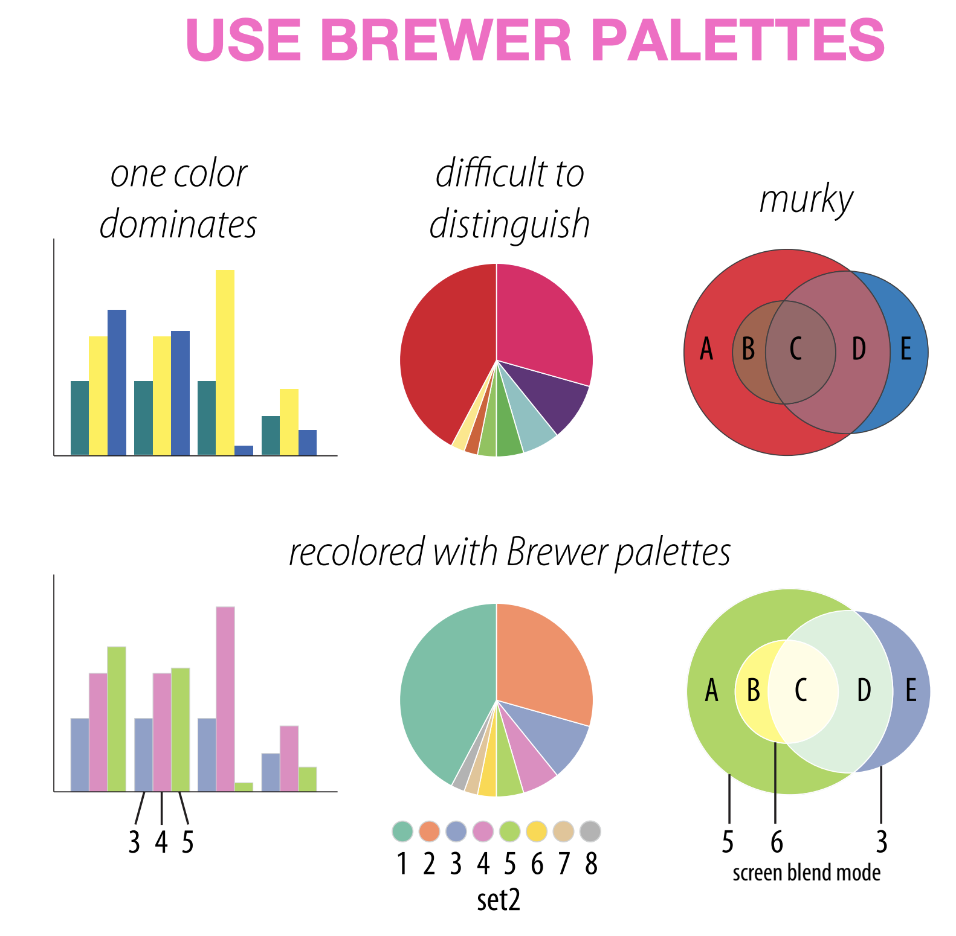
Which series is more effective (top or bottom)?
Martin Krzywinski

Slide 56
Which series is more effective (top or bottom)?
Martin Krzywinski

Slide 57
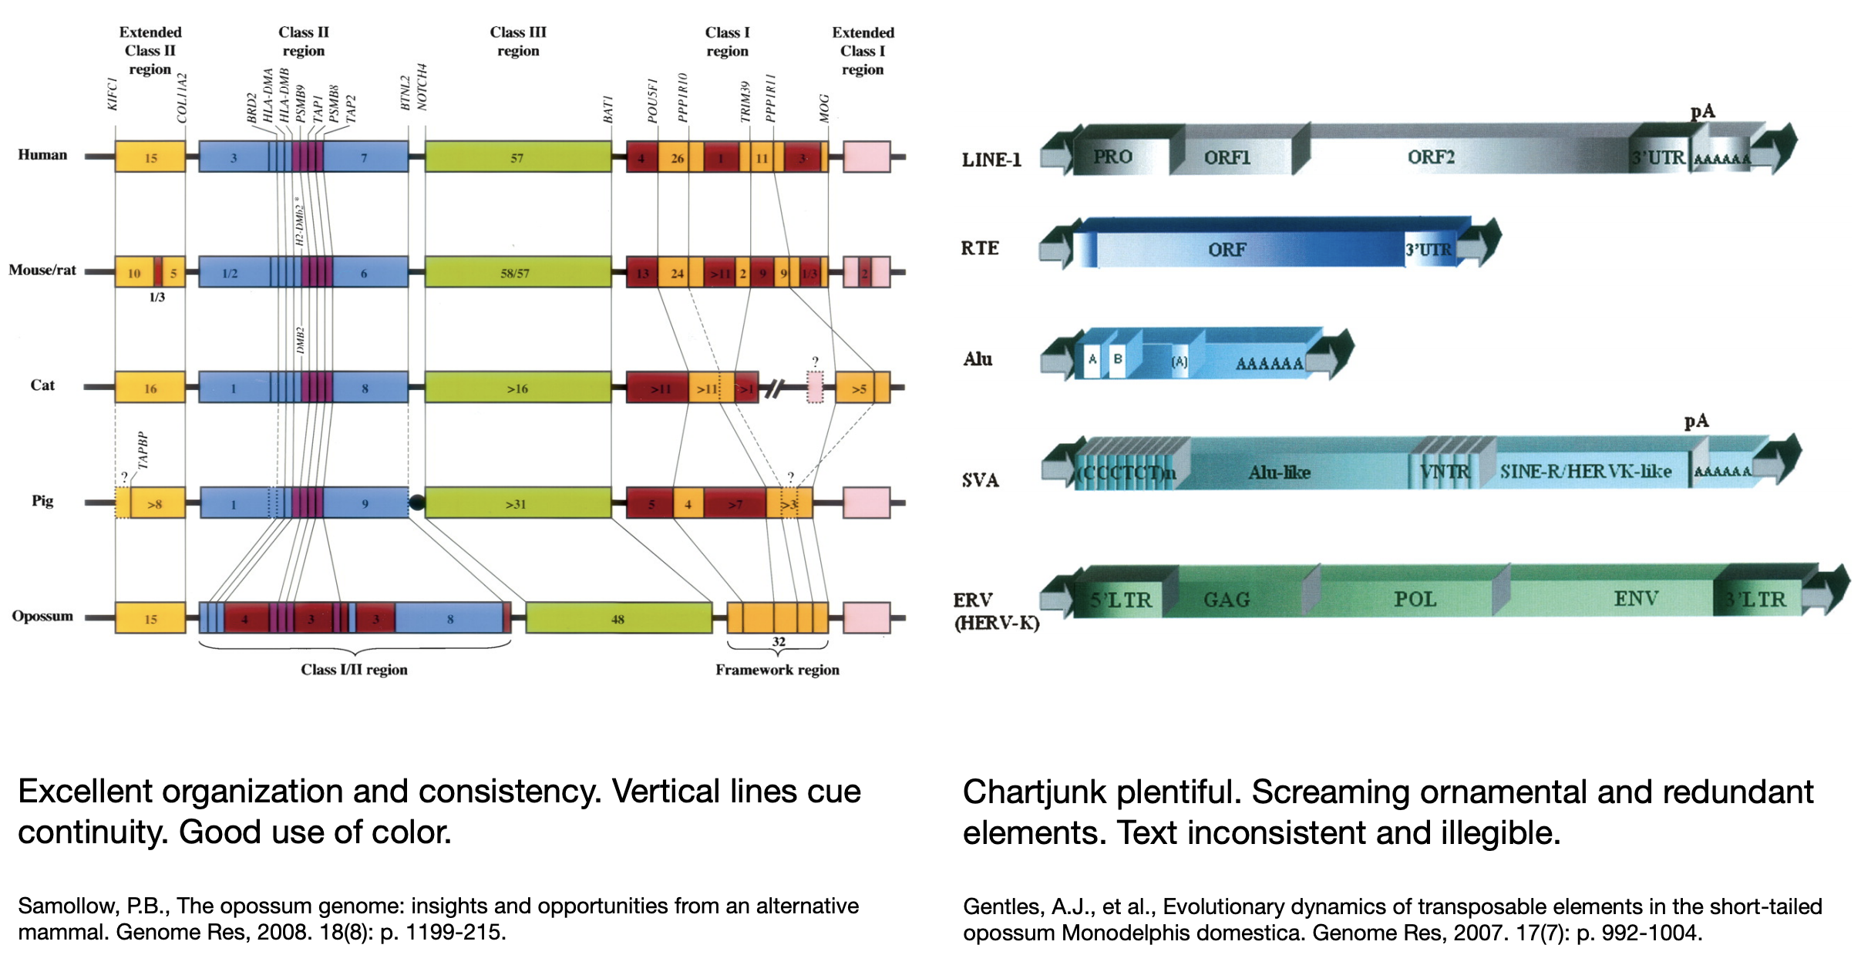
Which is more effective (left or right?)
Martin Krzywinski

Slide 58
Which is more effective (left or right?)
Martin Krzywinski

Slide 59
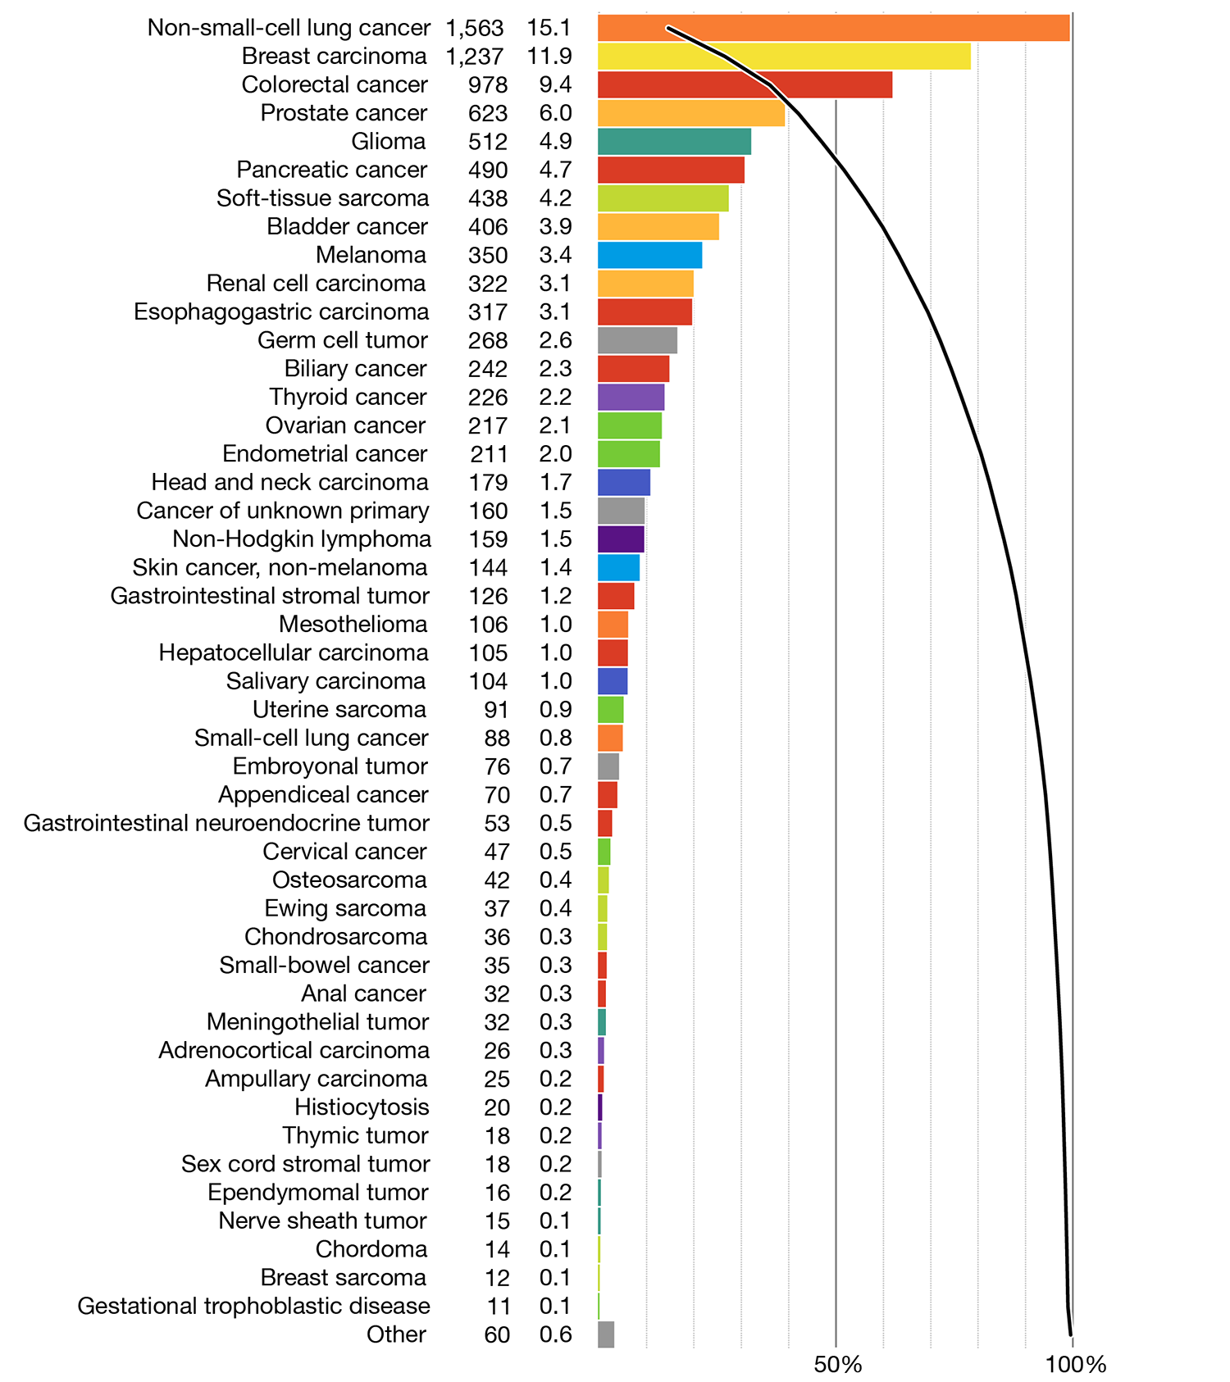
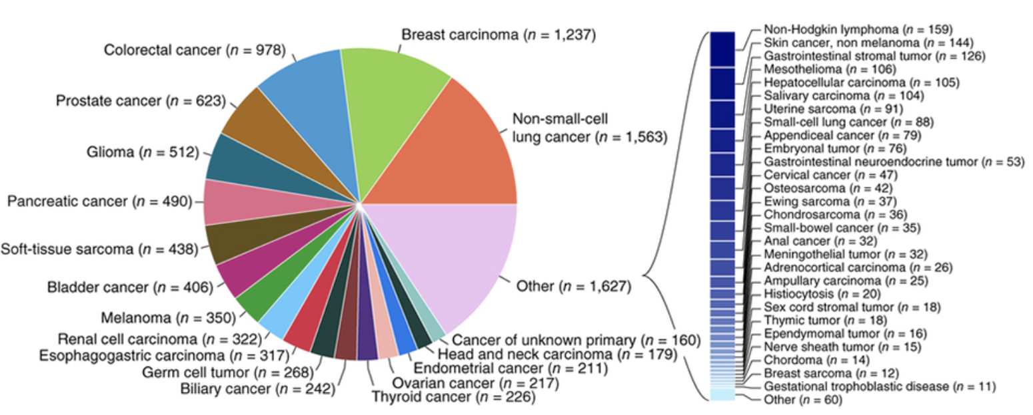
Which is more effective (left or right?)
Martin Krzywinski

Slide 60
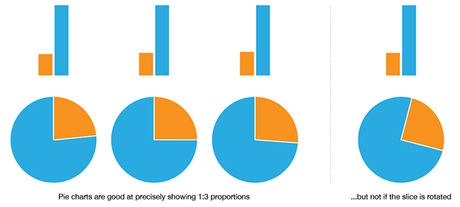
When to use a pie chart
Martin Krzywinski
Notes:
The pie chart is more intuitive than a bar plot when you have two numbers in a 1:3 proportion. Even then, it only works well when the slice is aligned. Basically if your data is more complex than this, the pie chart starts to suck pretty quickly.

Slide 61
When to not use a pie chart
Ahmet Zehir et al. (2017) Nature Medicine doi:10.1038/nm.4333
Hard to judge proportions
Poor use of color
Hard to read labels
Over ½ of the categories had to broken out of the pie chart
Martin Krzywinski

Slide 62
Same data with a redesigned approach
Martin Krzywinski
Notes:
Note the use of colors that are easy to distinguish from one another.
Now all data is displayed in the same way
Now we have bot the absolute numbers of cases, and the proportions of total listed on the left
Now we are able to show them in descending order. Instead of searching and parsing the relative size of the pie slices.
Finally, note the overlaid line that we can use to assess the cumulative proportion of all cases represented by the top N categories.

Slide 63
Selected articles on fundamentals of data viz
Visualizing samples with box plots
Circos plots
When to use (and not use) pie charts
Resources for choosing colors
http://colorbrewer2.org/
http://mkweb.bcgsc.ca/color/
Understanding and using Color Palettes
Color palettes for color blindness
Names for >9000 colors
Including 40 beer colors
Credit to Martin Krzywinski for his extensive work in this area and many of the above resources

Slide 64
Best practices in visualization

Slide 65
Best practices from this workshop
*Always* label axes
Consider readability of font size
Avoid vertical or angled text if possible
Avoid unnecessary use of color, point shapes, etc.
Chose colors wisely
If individual data points are being plotted and have started to really pile up on top of each other consider using a density function
Always be transparent about what data manipulation is taking place (e.g. log scale, filtering of outliers, etc.)

Slide 66
Best practices from the experts
Ten Simple Rules for Better Figures (Rougier et al. 2014):
Scientific visualizations should act as a “a graphical interface between people and data”. Try to follow these rules.
Know Your Audience
Identify Your Message
Adapt the Figure to the Support Medium
Captions Are Not Optional
Do Not Trust the Defaults
Use Color Effectively
Do Not Mislead the Reader
Avoid “Chartjunk”
Message Trumps Beauty
Get the Right Tool

Slide 67
Example visualizations using R

Slide 68
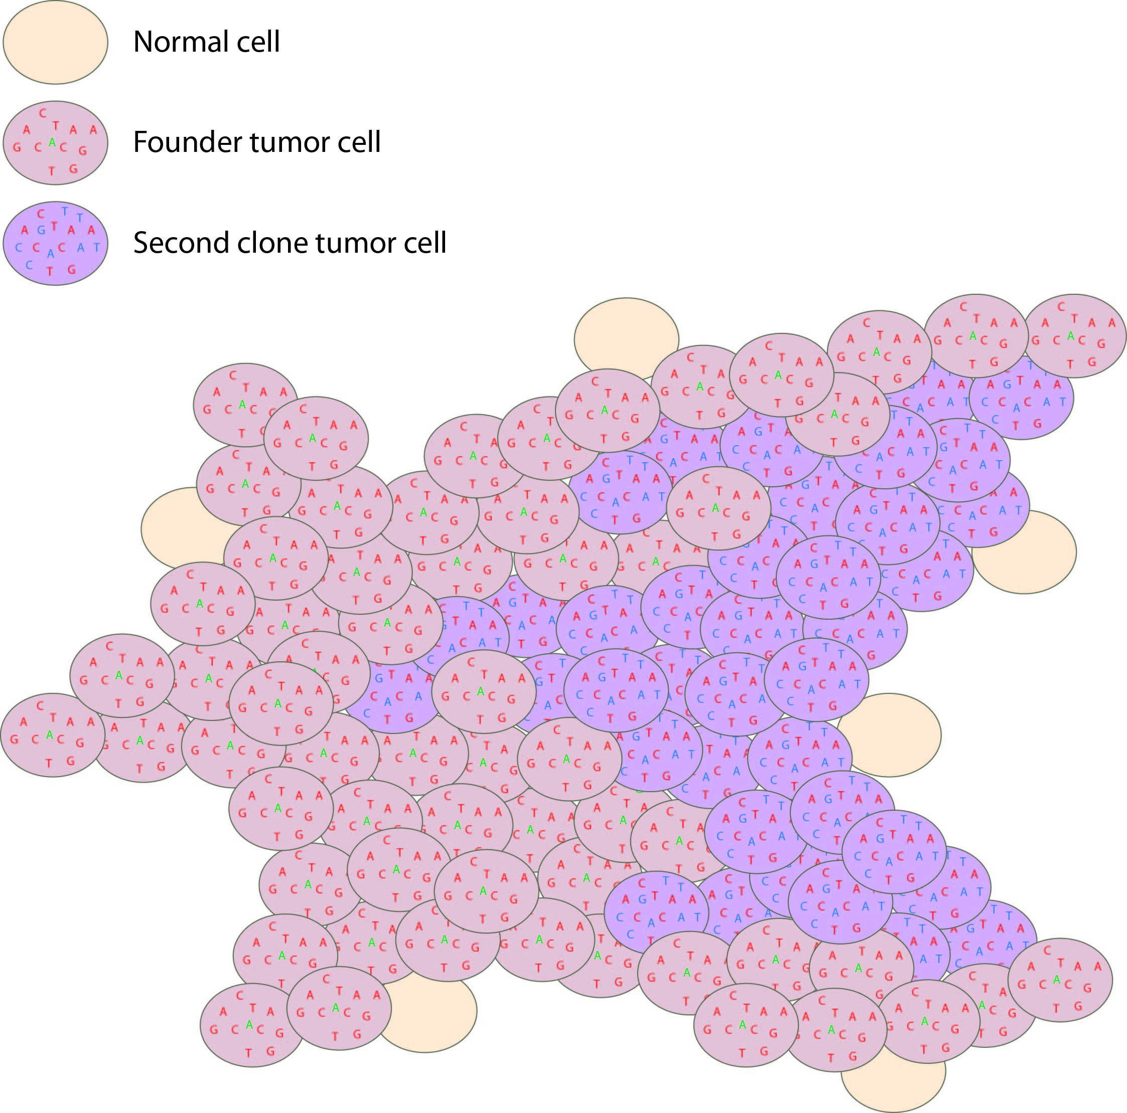
Histogram and scatterplot to define cell populations
Tumor variant allele frequency
Proportion
NF1
Read coverage (X)
WGS data
Tumor variant allele frequency
Tumor variant allele frequency

Slide 69
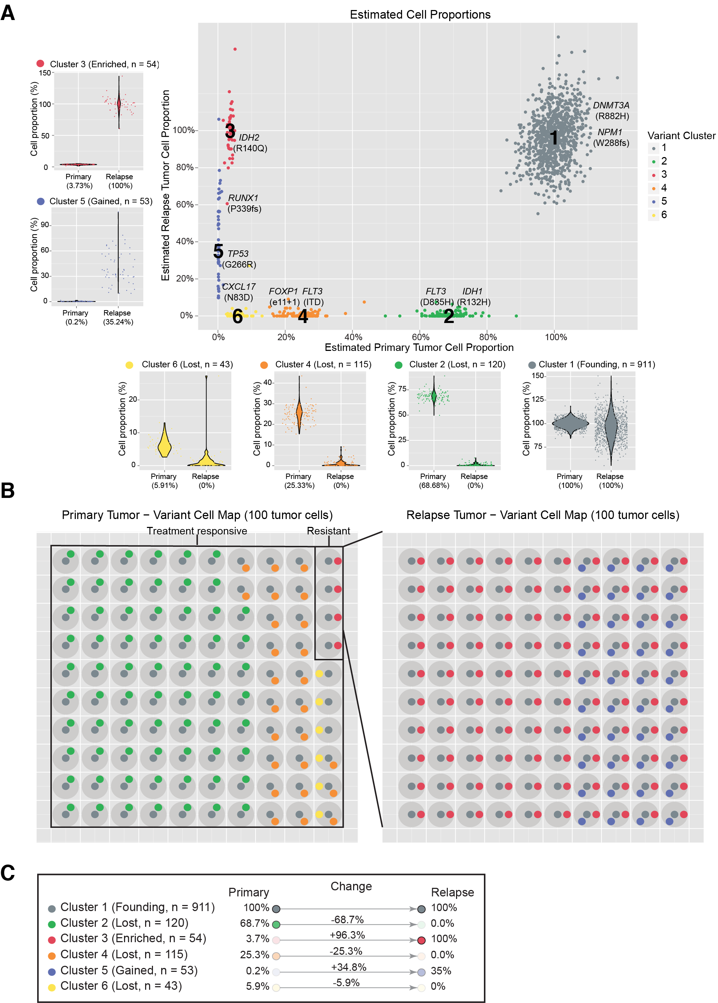
Clustering to define to distinct cell populations
Notes:
If we overlay each of these mutations on the rest of the platinum variants and use a clonality inference tools like SciClone we can resolve 6 different sub-clones, each with a couple driver mutations present. Except sub-clone 6. Based on our experiences so far we probably still haven’t sequenced deeply enough to find a driver event in that sub-clone yet.
You can see how in each of the surrounding plots, a shift in VAF distribution is occurring between primary and relapse.

Slide 70
Using a “cell map” to represent the variant clusters in 100 hypothetical cells of a tissue

Slide 71
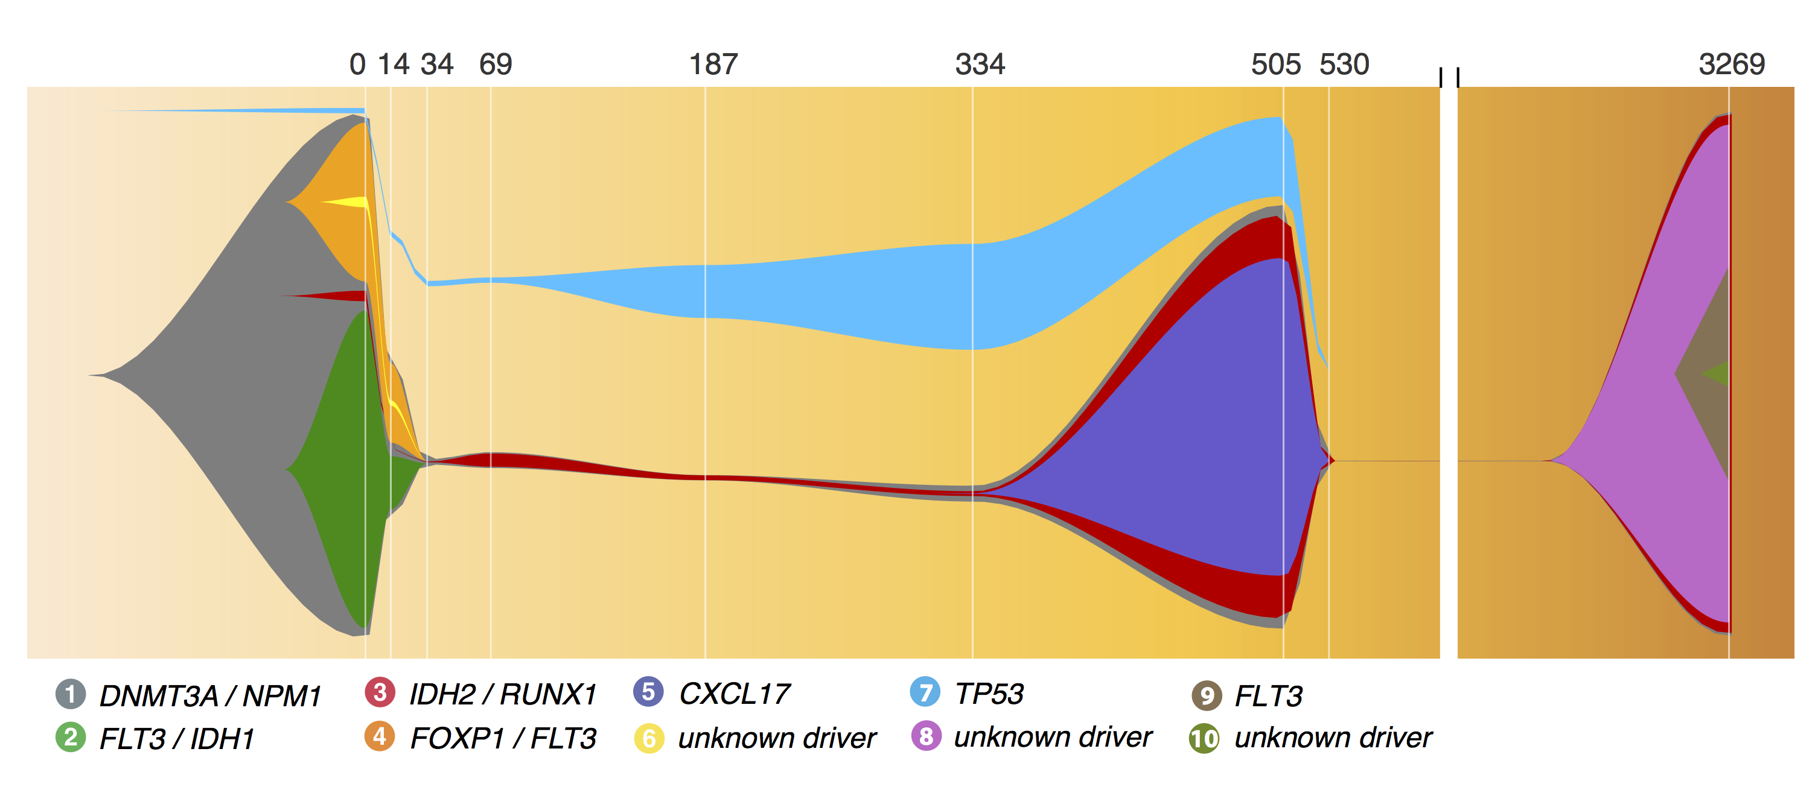
A ‘fish’ plot is used to represent sub-clones lost and gained over time

Slide 72
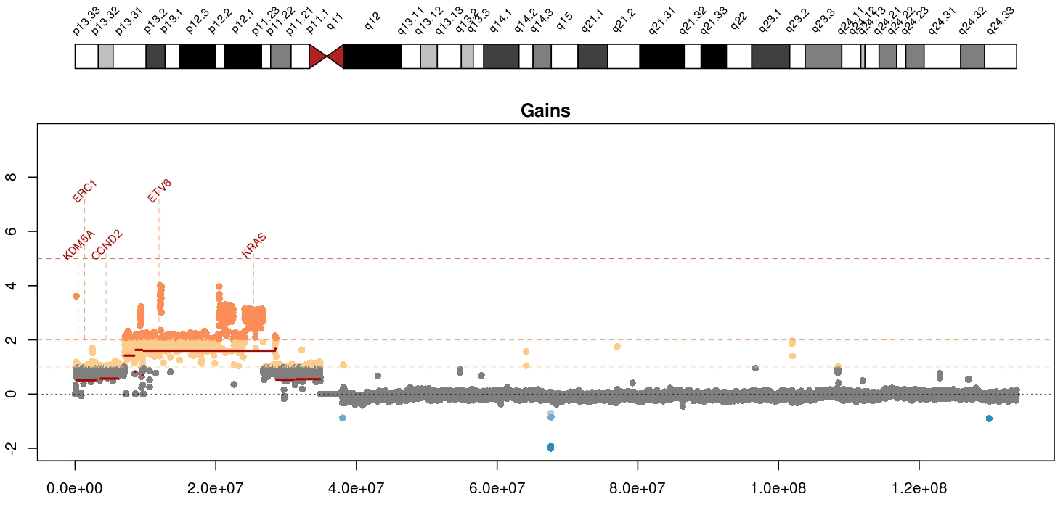
Visualizing copy number variation
Mean tumor-normal depth per 10kb window plotted
KRAS amplification in a metastatic breast cancer
Notes:
Whole genome data is exceptionally good a detecting copy number alterations in tumors. You essentially get a beautiful digital karyotype for each tumor. Here we see a complex amplification affecting KRAS and ETV6 and other critical cancer genes by both single copy and two copy gains.
We currently use cnv-hmm, CopyCat, and CnView for this kind of copy number analysis

Slide 73
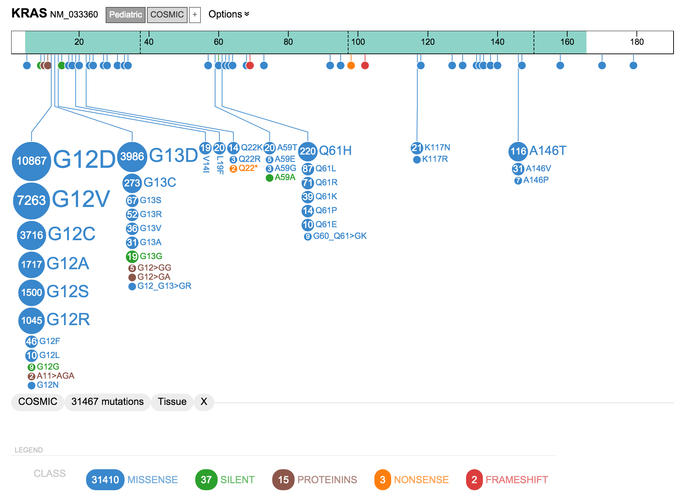
A ‘lollipop’ plot is used to variant recurrence in a gene
* Actually this one used “ProteinPaint” a web based tool we will try

Slide 74
A ‘waterfall’ plot is one way to visualize the pattern of recurrence in a cohort
https://github.com/griffithlab/GenVisR

Slide 75
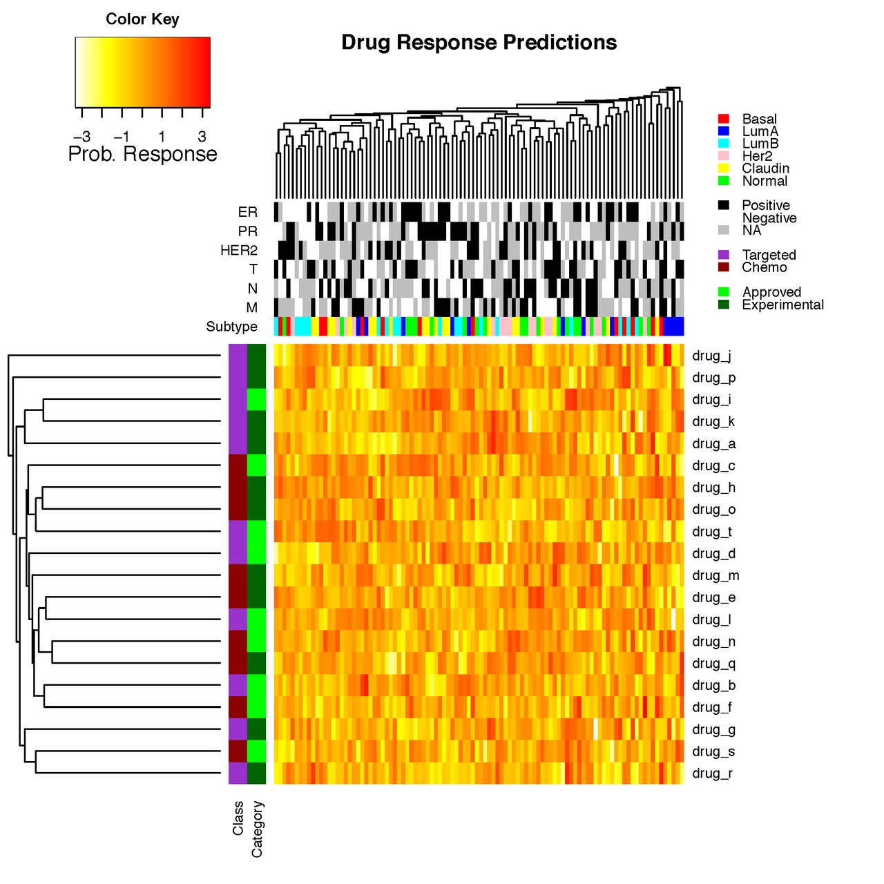
Heatmaps are a common way to simultaneously visualize multiple features of a dataset

Slide 76
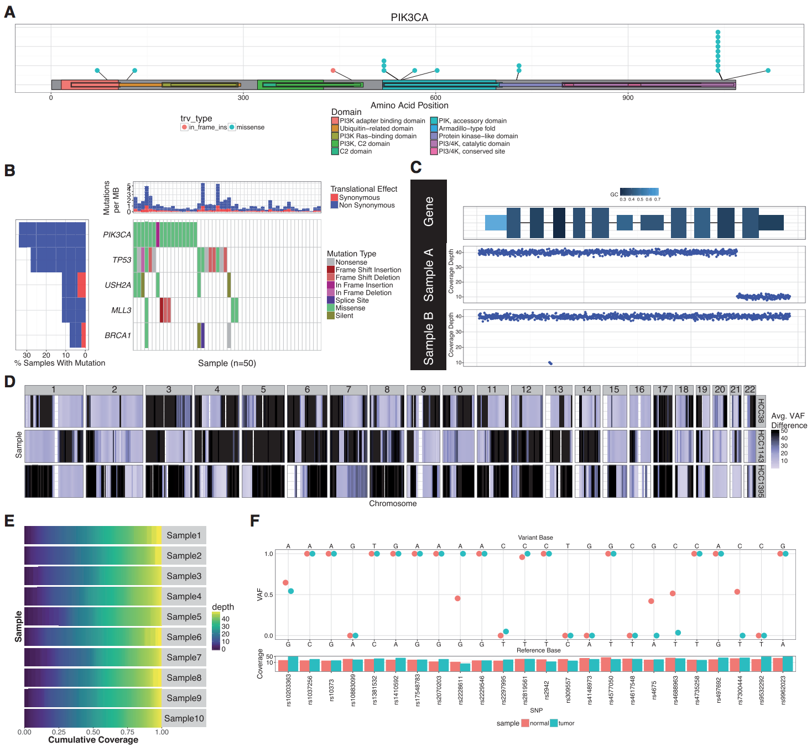
GenVisR was created to help others make common genomic visualizations

Slide 77
Introduction to GenViz course site
www.genviz.org

Slide 78
Tutorial for module 1
www.genviz.org/course/#module-1

